Slide 1
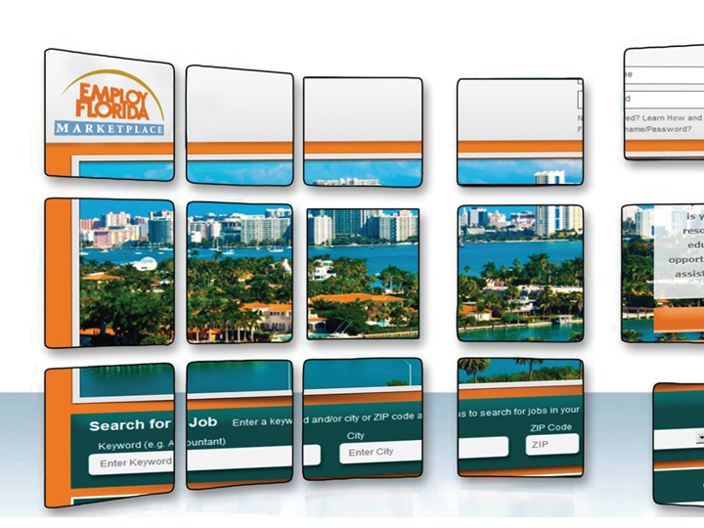

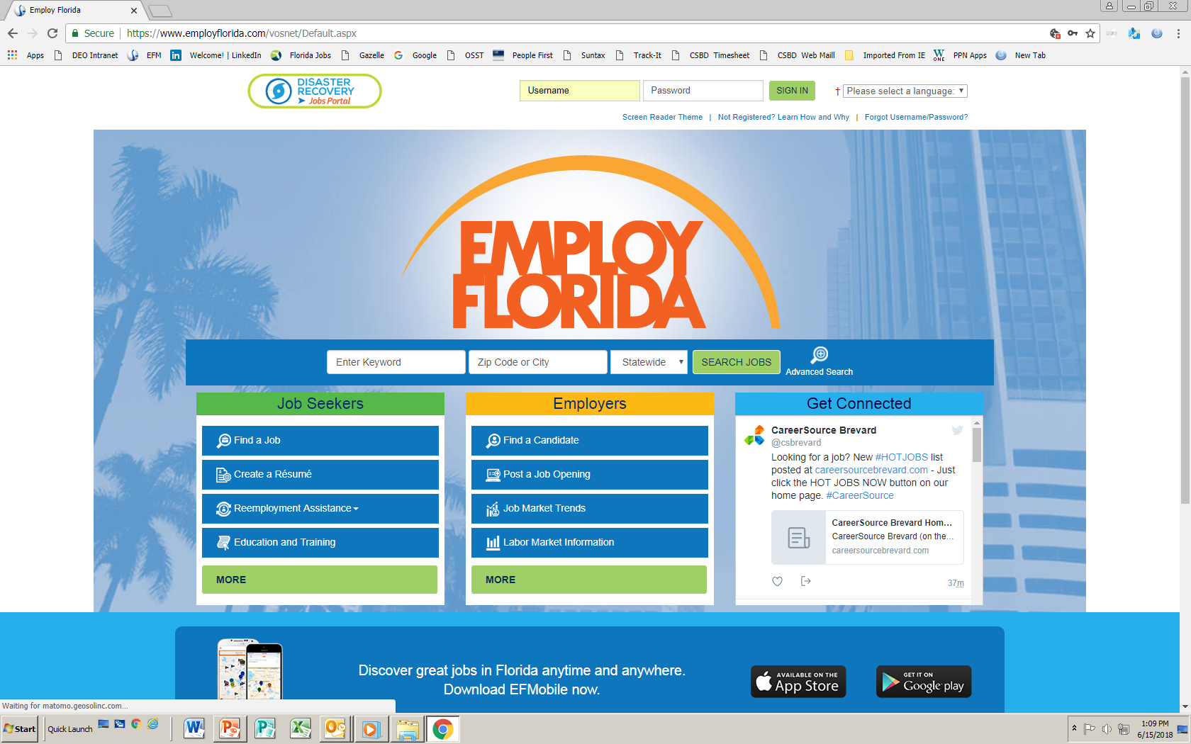
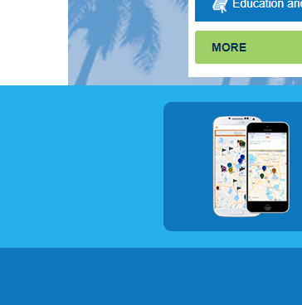


Name of presentation
Getting the Most Out of Employ Florida and the Internet
Navigating Employ Florida Website Workshop
Notes:
ef

Slide 2


Presentation Outline
Learn how to register for Employ Florida.
Use Employ Florida as a career assessment tool to identify your Abilities, Skills and Knowledge (ASK).
Expand your knowledge of Employ Florida (EF) and get a stronger understanding of its uses for your job search.
www.careersourcebroward.com
Notes:
ef

Slide 3
Employ Florida
  Employ Florida is your first source for generating leads and finding open positions throughout the state of Florida. Employ Florida provides many useful tools:
  Career Exploration: local job market information, career tips, etc.
  Career Assessment: assistance in matching your job skills to careers you qualify for
  Job Seeking: use of a professional format to create and send résumés and cover letters to employers
  Job Searching: review and apply for virtually every job listing available online at Employ Florida
Page 2
www.careersourcebroward.com
Notes:
ef

Slide 4
Employ Florida
www.employflorida.com
  From this page, you can:
  Search for Jobs
  Create a Résumé
  Receive Re-employment Assistance
  Find Education and Training
Page 2
www.careersourcebroward.com
Notes:
ef

Slide 5
Employ Florida
Creating a User Account
Page 2
www.careersourcebroward.com
Notes:
ef

Slide 6
Employ Florida Registration
To register in Employ Florida:
Open your internet browser
Enter the following in the address bar: www.employflorida.com
If not registered, click on Not Registered
You will be presented with 3 options
Page 2
www.careersourcebroward.com
Notes:
ef

Slide 7
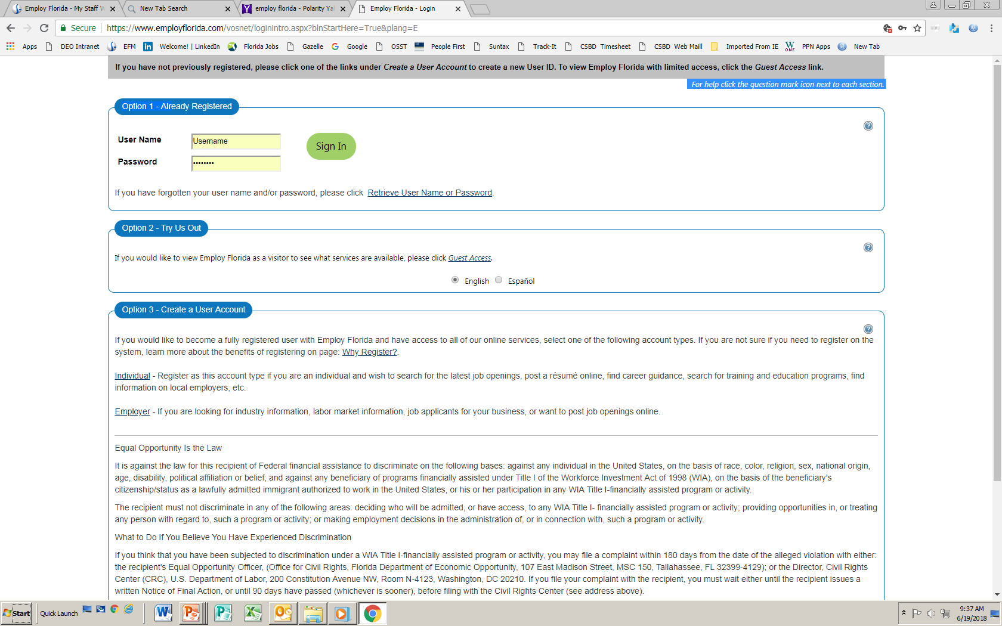
Employ Florida Registration
If you have already registered, but have forgotten your user name and/or password, click on Retrieve User Name or Pass Word. Word.ordegistered, you will be presented with 3 Options:
Option 1 – Already Registered
?
User Name
Username
……..
Sign In
Password
If you have forgotten your user name and/or password please click Retrieve User Name or Pass Word
Page 2
www.careersourcebroward.com
Notes:
ef

Slide 8
Employ Florida Registration
If you do not wish to create a user account at this time, you may click on Guest Access; you will not be able to use all Employ Florida’s features unless you register, however.
Option 2 – Try Us Out
?
If you would like to view Employ Florida as a visitor to see what services are available please click Guest Access
English
Español
Page 2
www.careersourcebroward.com
Notes:
ef

Slide 9
Employ Florida Registration
Option 3 is to create a User Account. Instructions for this follow.
Option 3 – Create a User Account
?
If you would like to become a fully registered user with Employ Florida and have access to all of our online services select one of the account types. If you are not sure if you need to register on the system, learn more about the benefits of registering on page: Why Register?
Individual – Register as this account type if you are an individual and wish to search for the latest job openings, post a résumé online, find career guidance, search for training and education programs, find information on local employers, etc.
Employer – If you are looking for industry information, labor market information, job applicants for your business, or want to post job openings online.
www.careersourcebroward.com
Notes:
ef

Slide 10
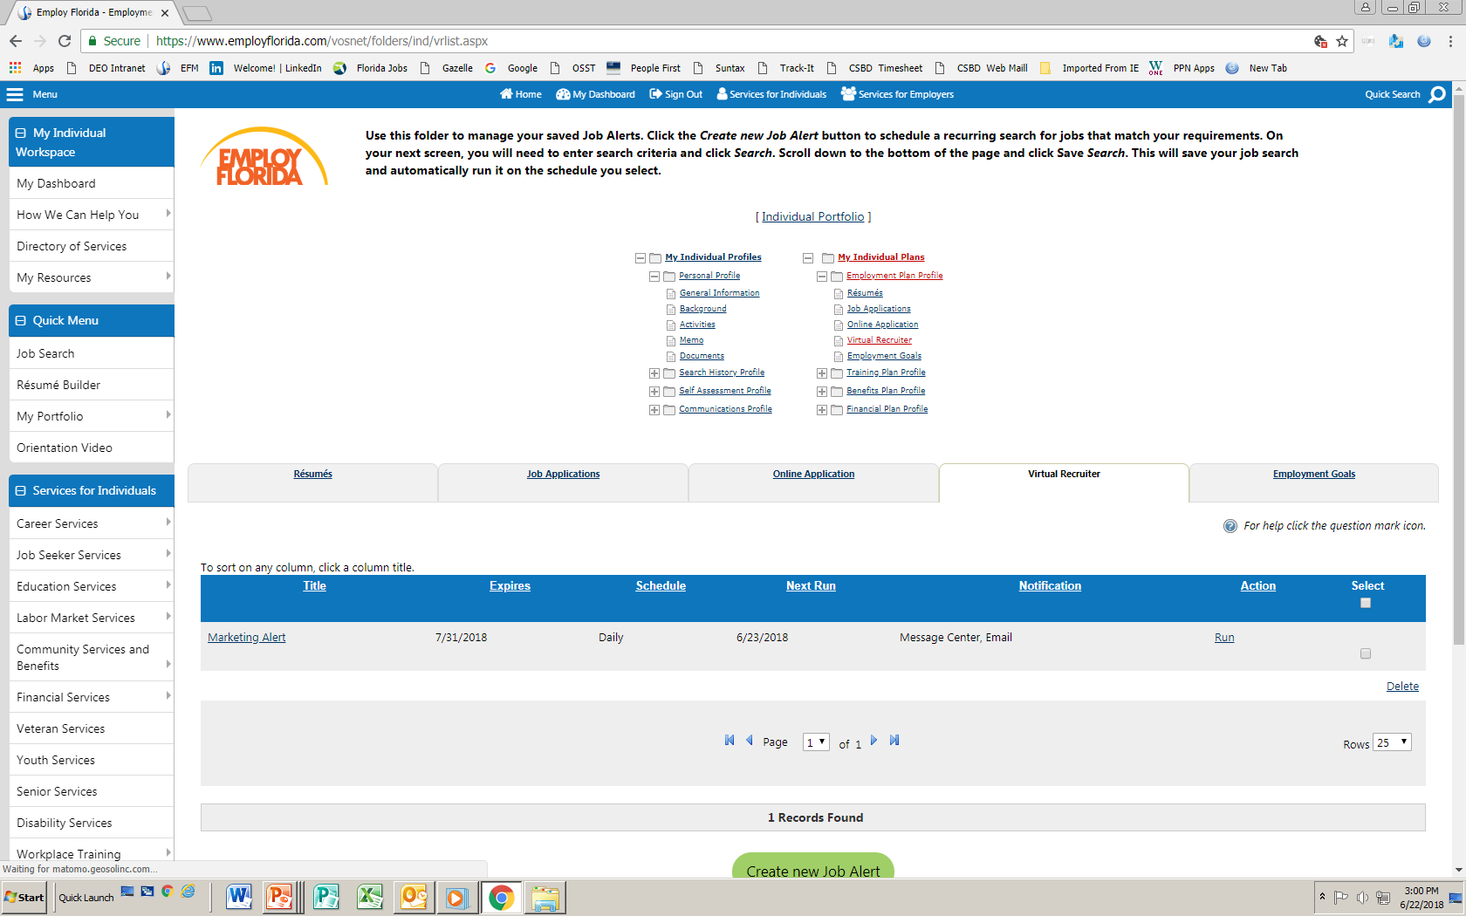
Creating a User Account
Step 1
Home
]
Register/Sign in
Services for Individuals
Services for Employers
Please enter the following login information and click the Next button when you are finished. Be sure to remember your User Name and Password.
You will need them to access the system again.
For help click the question mark icon next to each section.
* Indicates required fields.
Login Information
?
* User Name
Enter User Name (3-20 characters and must include characters, letters and numbers. Allowable characters are + @ _)
.
* Password
Enter Password (8-16 characters and must include at least one uppercase letter, one lower case letter, one number and one special case character. Allowable characters are # & $ % + ^ ! * _)
.
* Confirm Password
* Security Question
None Selected
* Security Question Response
Special characters are not allowed.

Slide 11
Creating a User Account
Step 2
Home
]
Register/Sign in
Services for Individuals
Services for Employers
Please enter the following login information and click the Next button when you are finished. Be sure to remember your User Name and Password.
You will need them to access the system again.
For help click the question mark icon next to each section.
* Indicates required fields.
Social Security Number
* Social Security Number
SSN:
Do not enter dashes (for example 999001111)
* Reenter Social Security
Number:

Slide 12
Creating a User Account
Step 3
Home
]
Register/Sign in
Services for Individuals
Services for Employers
Please enter the following login information and click the Next button when you are finished. Be sure to remember your User Name and Password.
You will need them to access the system again.
For help click the question mark icon next to each section.
* Indicates required fields.
Primary Location Information
* Country
* Please enter your zip code
Find Zip Code
* Are you authorized to work in the United States?
Yes
No
Complete all required fields and click the NEXT button.
Notes:
ef

Slide 13
Creating a User Account
Note Failure to register properly in Employ Florida will result in one or more of the following error messages:
User Name is a required field.
Password is a required field.
Confirm Password is a required field.
Security Question is a required field.
Security Question Response is a required field.
Social Security Number (SSN) is a required field.
Re-enter Social Security Number is a required field.
Country is a required field.
Please enter your Zip Code is a required field.
Are you authorized to work in the United States is a required field.
Page 2
www.careersourcebroward.com
Notes:
ef

Slide 14
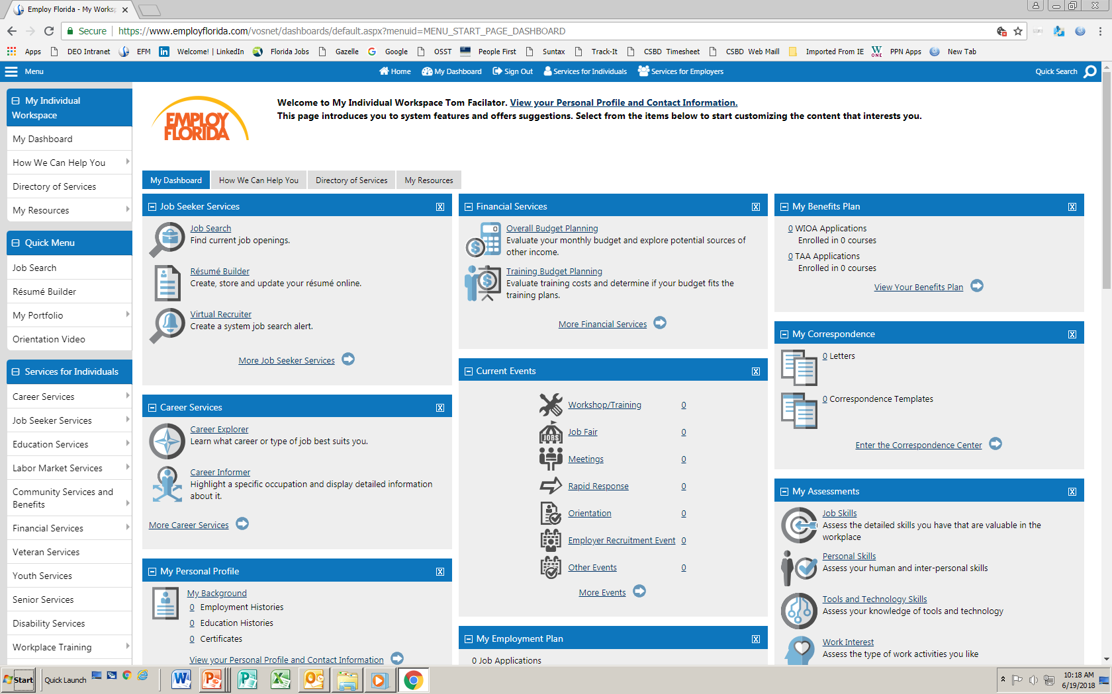
Employ Florida Home Page
Successful User log-in will show the Employ Florida Homepage.
Click on
Job Seeker Services.
Page 2
www.careersourcebroward.com
Notes:
ef

Slide 15
Job Seeker Services
]
Menu
Home
Register/Sign in
Services for Individuals
Services for Employers
Services for Employers
Job Seeker Services contains tools to secure employment:
Job Search
Résumé Builder
Virtual Recruiter
Job Search and Résumé Builder are also found on Quick Menu
Job Search
Job Search
Résumé Builder
Résumé Builder
Virtual Recruiter
Page 2
www.careersourcebroward.com
Notes:
ef

Slide 16
Employ Florida
Using the Résumé Builder
Page 2
www.careersourcebroward.com
Notes:
ef

Slide 17
Résumé Builder Overview
To effectively utilize Employ Florida, the résumé should be created outside Employ Florida (using word processing software) prior to uploading it.
The résumé should include the following sections:
  Contact information
  Job title
  Summary
  Skills
  Achievements (Optional)
  Education
  Training (Optional)
  Certifications (Optional)
  Employment History
      The company name
      The position held
      The start and end date of employment
      A description of activities for that position
Page 2
www.careersourcebroward.com
Notes:
ef

Slide 18

Creating a Résumé on Employ Florida
Menu
Home
]
Sign Out
Services for Individuals
My Dashboard
Services for Employers
To begin the Résumé Builder process, click on Résumé Builder from Quick Menu or from Job Seeker Services.
Page 2
www.careersourcebroward.com
Notes:
ef

Slide 19
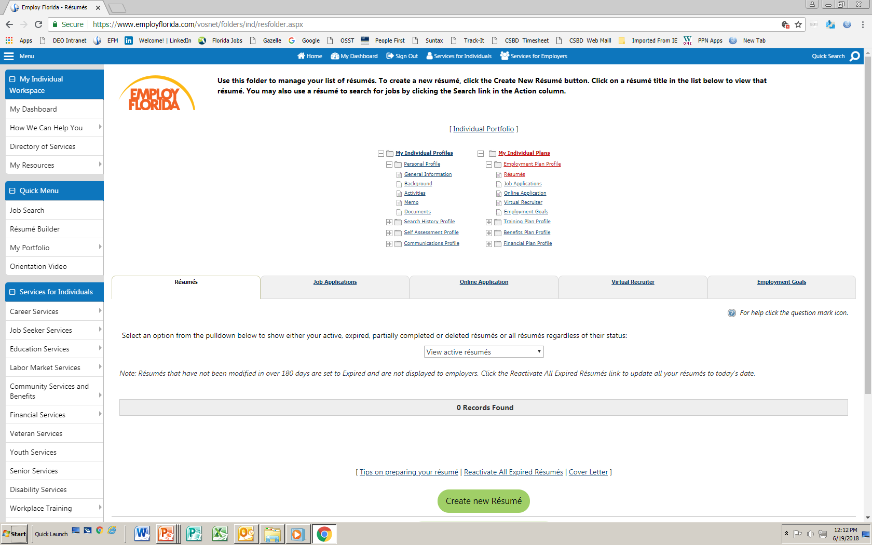
The Résumés Tab
[Individual Portfolio]
From the Résumés tab, the Job Seeker is given the options to either View active résumés or Create new Résumé.
My Individual Profiles
My Individual Plans
Personal Profile
Employment Plan Profile
General Information
Résumés
Background
Job Applications
Activities
Online Application
Memo
Virtual Recruiter
Documents
Employment Goals
Search History Profile
Training Plan Profile
Self Assessment Profile
Benefits Plan Profile
Communications Profile
Financial Plan Profile
Résumés
View active résumés
Create new Résumé
www.careersourcebroward.com
Notes:
ef

Slide 20
Create new Résumé
Résumés
Job Applications
Online Application
Select the GREEN tab: Create new Résumé.
View active résumés
Create new Résumé
Page 2
www.careersourcebroward.com

Slide 21
Résumés on Employ Florida
  Create a title for your résumé: “Data Entry Résumé”, for example.
  Employ Florida provides the following Résumé formats:
    Comprehensive
    Upload
    Copy & Paste
    Quick
  Be specific and provide as much detail as possible.
  Use Key Words to make it easier for Employers to find you.
Page 2
www.careersourcebroward.com
Notes:
ef

Slide 22
Résumé Name
Menu
Home
]
Sign Out
Services for Individuals
My Dashboard
Services for Employers
Résumé Upload Builder
Title
Résumé Extraction
Employer Search Items
Education
Certifications
Employment
Job Skills
Ability Summary
Objective
Honors & Activities
Additional Information
Contact
References
The User completes the Résumé Title section.
*Indicates required field
Résumé Name
* Résumé Title
Manager Sales and Marketing
Note: You may want to include words that highlight your skills, experience or specialty. Also, please be advised that this is a searchable field by Employers if you choose to have
Allow employers to view my résumé online.
Hide my résumé from employers.
Show résumé best practices
Résumé Creation Method
Comprehensive.
Build your résumé using a step-by-step process. (create your résumé from scratch)

Slide 23

Résumé Creation Method
Résumé Upload Builder
Title
Résumé Extraction
Employer Search Items
Education
Certifications
Employment
Job Skills
Under Résumé Creation Method, select your preferred method (such as Upload), then Click Next>>.
Ability Summary
Objective
Honors & Activities
Additional Information
Contact
References
Résumé Creation Method
Comprehensive.
Build your résumé using a step-by-step process. (create your résumé from scratch).
PDF
Upload
Attach an existing Word or PDF résumé (save time by using your existing résumé).
Copy & Paste
Transfer résumé’s text from an existing copy (quick but not as useful to potential employers).
Quick
Create a résumé with minimal data entry. This will allow you to start applying for jobs more quickly, but may not provide better match results.
<< Back
Next >>
Notes:
ef

Slide 24
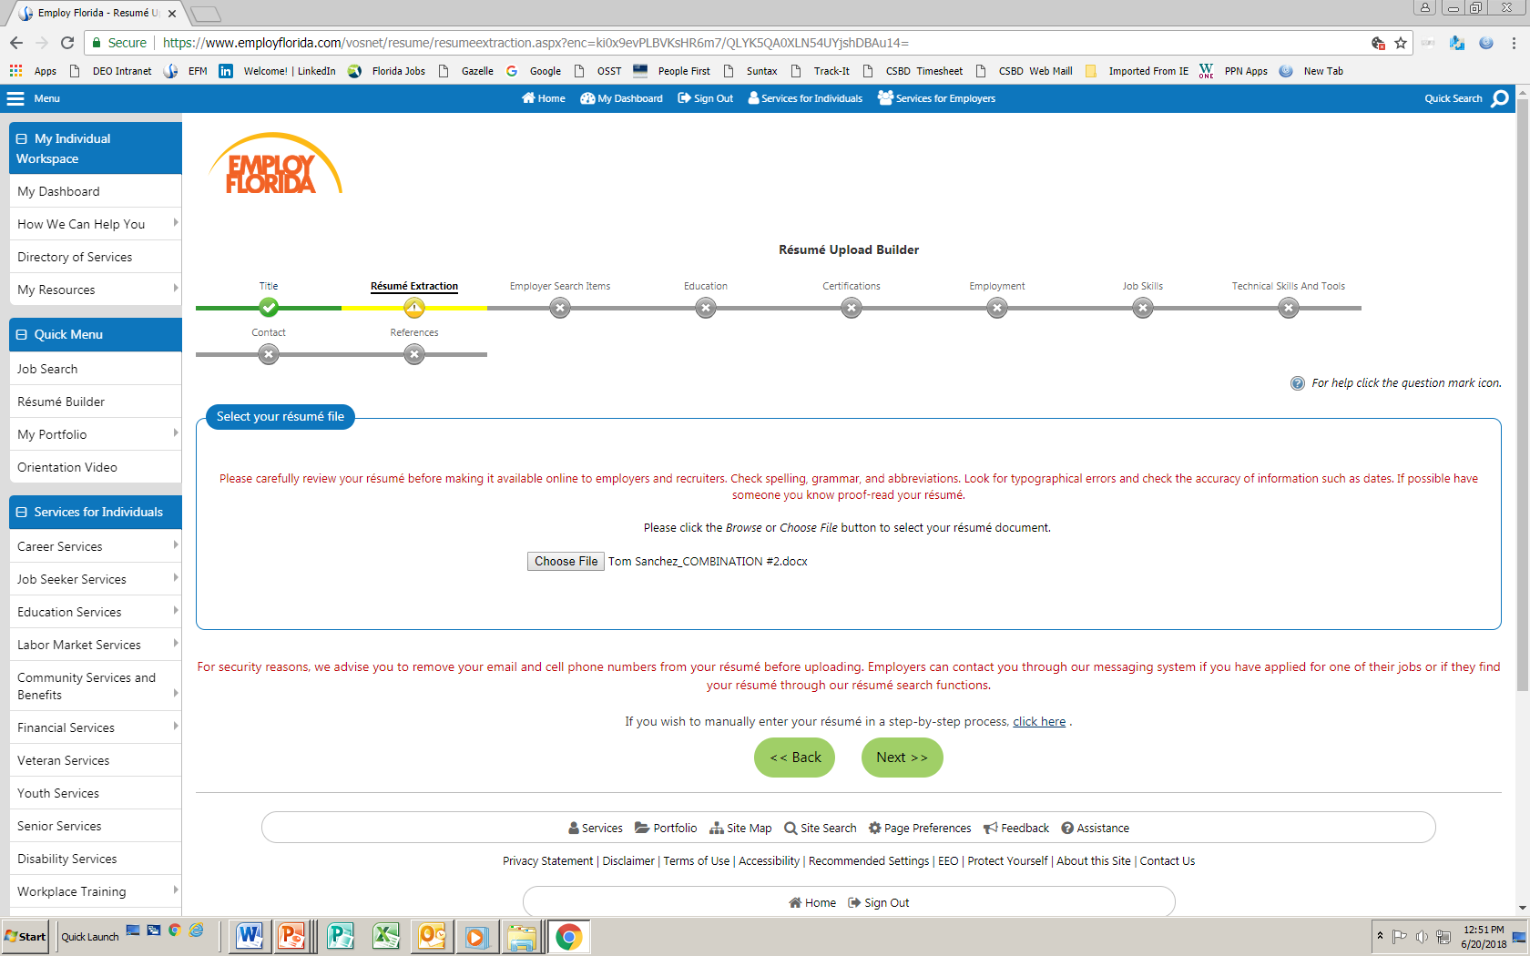
Uploading a Résumé
Menu
Home
]
Sign Out
Services for Individuals
My Dashboard
Services for Employers
The User selects the location of the résumé to upload to EF. Select the Choose File icon. Choose the file from wherever you have saved it, then click Next>>.
Résumé Upload Builder
Title
Résumé Extraction
Employer Search Items
Education
Certifications
Employment
Job Skills

Ability Summary
Objective
Honors & Activities
Additional Information
Contact
References
Select your résumé file
Please carefully review your résumé before making it available online to employers and recruiters. Check spelling, grammar
Please click the Browse or Choose File button to select your résumé document
Choose File
Tom Sanchez_COMBINATION#2.docx
<< Back
Next >>
www.careersourcebroward.com
Notes:
ef

Slide 25
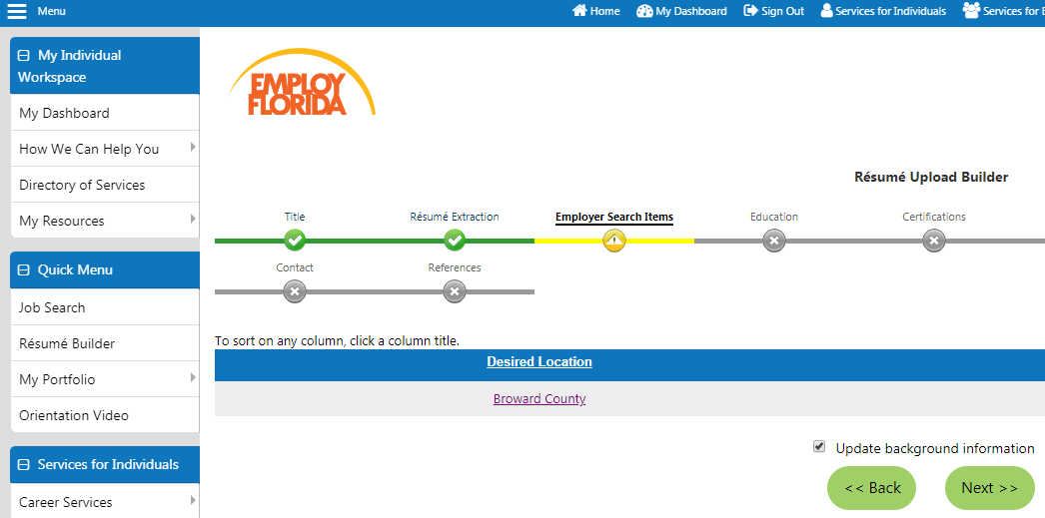
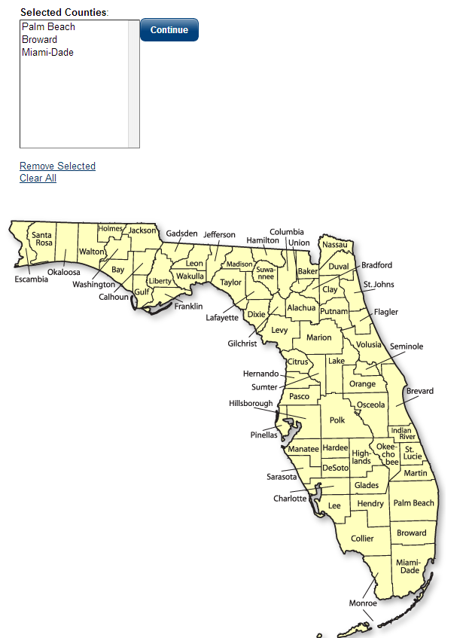
Desired Location
Menu
Home
]
Sign Out
Services for Individuals
My Dashboard
Services for Employers
Résumé Upload Builder
Title
Résumé Extraction
Employer Search Items
Education
Certifications
Select the desired location where you would like to work. To change the area, click on Desired Location and chose available options.


Ability Summary
Objective
Honors & Activities
Selected Counties
Continue
Palm Beach
Broward
Miami-Dade
Broward County
Remove Selected
Clear All
Page 2
www.careersourcebroward.com
Notes:
ef

Slide 26
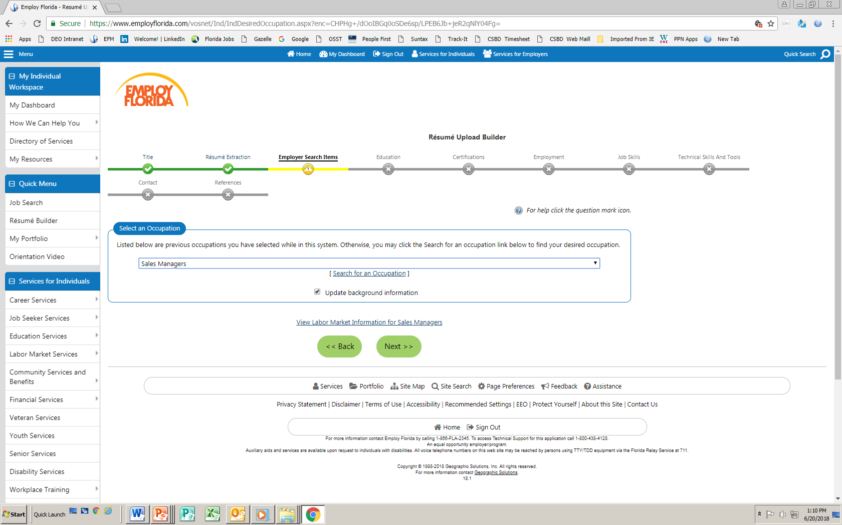

Select an Occupation
Menu
Home
]
Sign Out
Services for Individuals
My Dashboard
Services for Employers
Identify your desired career occupation by choosing Select an Occupation.
Résumé Upload Builder
Title
Résumé Extraction
Employer Search Items
Education
Certifications
Employment
Job Skills


Ability Summary
Objective
Honors & Activities
Additional Information
Contact
References
Select an occupation
Select what is applicable to you, then click Next>>.
Listed below are previous occupations you have selected while in this system. Otherwise you may click in the Search for an occ
Sales Managers
Sales Managers
Before you leave this page, make sure you check Update background information.
[Search for an occupation]
Update background information
<< Back
Next >>
Page 2
www.careersourcebroward.com
Notes:
ef

Slide 27
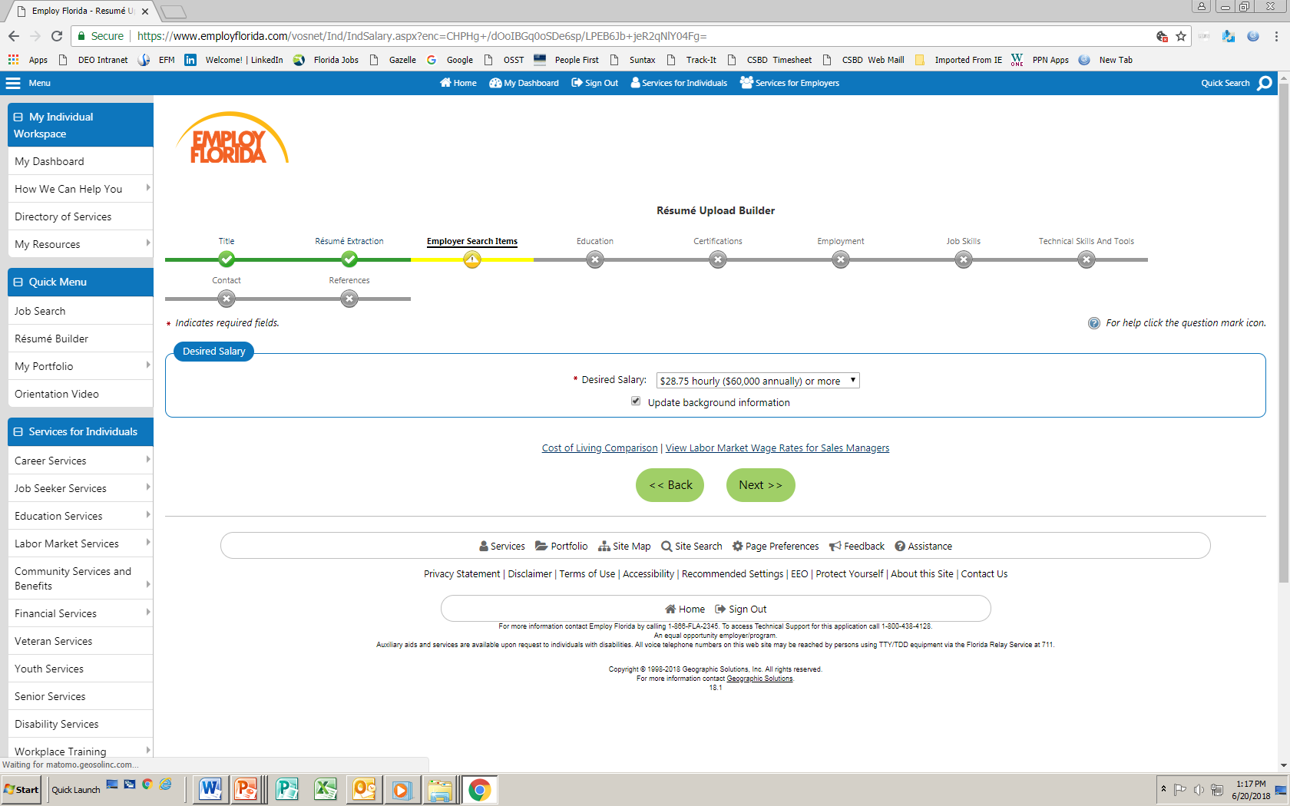
Desired Salary
Menu
Home
]
Sign Out
Services for Individuals
My Dashboard
Services for Employers
Identify your desired salary using the drop-down menu. click Next>>.
Résumé Upload Builder
Title
Résumé Extraction
Employer Search Items
Education
Certifications
Employment
Job Skills


Ability Summary
Objective
Honors & Activities
Additional Information
Contact
References
* Indicates required field
Desired Salary
* Desired salary:
$28.75 hourly ($60,000 annually) or more
Update background information
Select what is applicable to you, then Click “Next”
<< Back
Next >>
Page 2
www.careersourcebroward.com
Notes:
ef

Slide 28
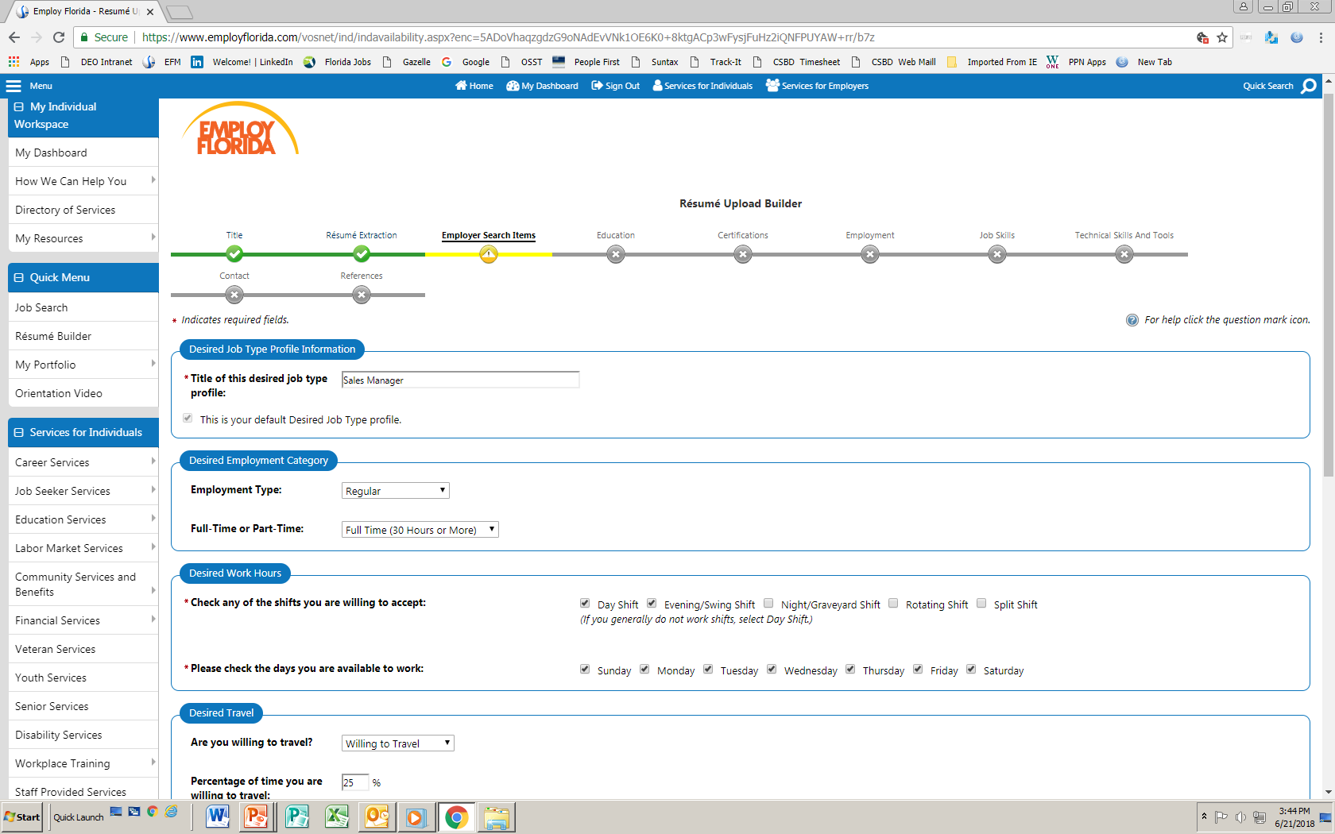
Other Employer Search Items
Résumé Upload Builder
Complete the required information as follows:
Desired Job Type Profile Information (ex: “Sales Manager”)
Desired Employment Category (ex: “Regular”)
Desired Work Hours (ex: “Day Shift, Evening/Swing Shift, etc.”)
Desired Travel (ex: “Willing to travel”)
Title
Résumé Extraction
Employer Search Items
Education
Certifications
Employment
Job Skills


1
Ability Summary
Objective
Honors & Activities
Additional Information
Contact
References
* Indicates required field
Desired Job Type Profile Information
1
2
* Title of this desired job type profile:
Sales Manager
This is your default Desired Job Type profile
3
Desired Employment Category
2
Employment Type
Regular
Full Time or Part Time
Full Time (30 hours or more)
4
Desired Work Hours
3
* Check any of the shifts you are willing to accept
□ Day Shift □ Evening/Swing Shift □ Night/Graveyard Shift □ Rotating Shift □ If you currently do not work shifts select Day Shift
* Please check the days you are available to work
□ Sunday □ Monday □ Tuesday □ Wednesday □ Thursday □ Friday □ Saturday
Desired Travel
4
Are you willing to travel?
Willing to travel
Percentage of time you are willing to travel
Page 2
25 %
Notes:
ef

Slide 29
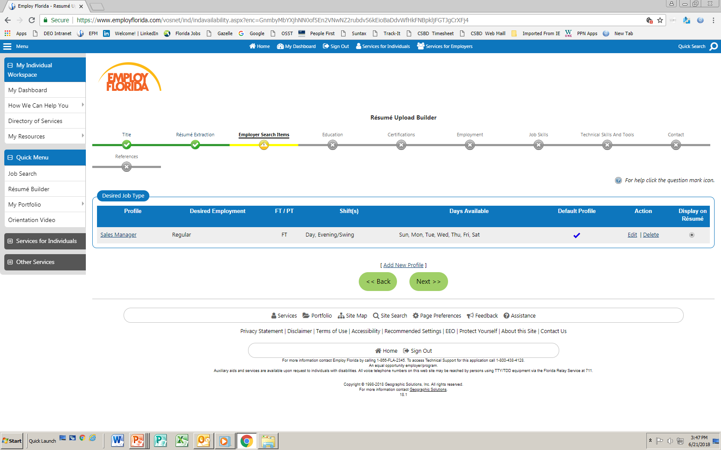
Desired Job Type
After checking to make sure everything is correct, click Next>>.
Résumé Upload Builder
Title
Résumé Extraction
Employer Search Items
Education
Certifications
Employment


Ability Summary
Objective
Honors & Activities
Additional Information
Contact
References
Desired Job Type
Profile
Desired Employment
FT/PT
Shift(s)
Days Available
Sales Manager
Regular
FT
Day, Evening/Swing
Sun, Mon Tue, Wed, Thu, Fri, Sat
[Add New Profile]
<< Back
Next >>
Page 2
www.careersourcebroward.com
Notes:
ef

Slide 30
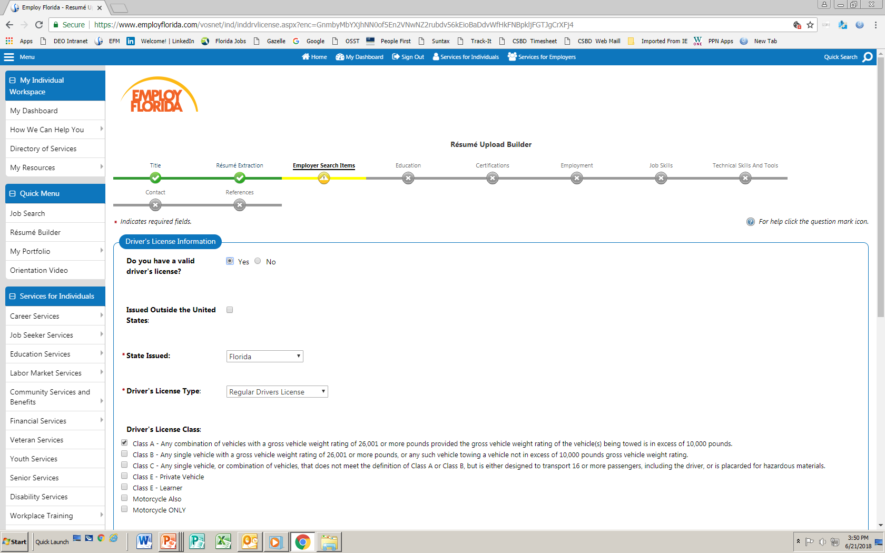
Driver’s License Information
Résumé Upload Builder
Building the profile includes identifying your Driver’s License Information, including State Issued and Driver’s License Type.
Title
Résumé Extraction
Employer Search Items
Education
Certifications
Employment
Job Skills


Ability Summary
Objective
Honors & Activities
Additional Information
Contact
References
* Indicates required field
.
Drive’s License Information
Do you have a valid driver’s license?
Yes
No
Issued outside the United States:
* State Issued:
Florida
* Driver’s License Type:
Regular Driver’s License
Driver’s License Class:
Class A – Any combination of vehicles with a gross weight rating of 26,001 or more pounds provided the gross vehicle weight
Class B – Any combination of vehicles with a gross weight rating of 26,001 or more pounds, or any such vehicle towing ang
Class C – Any single vehicle, or combination of vehicles, that does not meet the definition of Class A , or Class B, but is
Class E – Private vehicles
Class E – Learner
Motorcycle Also
Page 2
www.careersourcebroward.com
Notes:
ef [sic]

Slide 31
Other Employer Search Items
Complete the required information as follows:
Security Clearance
Languages and Proficiency
Typing Speed
When these are complete, click on Next>>.
Résumé Upload Builder
Title
Résumé Extraction
Employer Search Items
Education
Certifications
Employment
Job Skills


Ability Summary
Objective
Honors & Activities
Additional Information
Contact
References
* Indicates required field
Active Confidential
Security Clearance
What is you current security clearance?
Active Confidential
Languages and Proficiency
Language
Spanish
Well
[ Add a new Language ]
Typing Speed
Typing Speed
40+ wpm
<< Back
Next >>
Page 2
www.careersourcebroward.com
Notes:
ef

Slide 32

Education
Menu
Home
]
Sign Out
Services for Individuals
My Dashboard
Services for Employers
Résumé Upload Builder
Title
Résumé Extraction
Employer Search Items
Education
Certifications
Employment
Job Skills



Ability Summary
Objective
Honors & Activities
Additional Information
Contact
References
Educational information is extracted from the résumé. If data is missing, it will be identified in RED. Make corrections as needed.
* Indicates required field
Active Confidential
Education and Training
Do not complete for education levels of less than High School or High School Equivalency Diploma. Certifications and Occupational
* Qualification Level:
Master’s Degree
* Course of Study:
Marketing
Educational Program Classification:
Select Educational Program Classification
* Issuing Institution:
Florida A&M University
City:
Tallahassee
State / Province (of Institution):
Florida
.
Country (of Institution):
United States
* Are you currently attending this school?
1
Yes
No
Page 2
32
www.careersourcebroward.com
Notes:
ef

Slide 33
Education and Training
Menu
Home
]
Sign Out
Services for Individuals
My Dashboard
Services for Employers
Résumé Upload Builder
Title
Résumé Extraction
Employer Search Items
Education
Certifications
Employment
Job Skills



When your Education and Training information is correct, click on Next>>.
Ability Summary
Objective
Honors & Activities
Additional Information
Contact
References
* Indicates required field
Active Confidential
Education and Training
Qualification
Issuing Institution
Location
Completion Date
Master’s Degree
Florida A&M University
Tallahassee, FL
06/1999
Bachelor’s Degree
Empire State College
Albany, NY
06/1994
[ Add a new Educational History ]
<< Back
Next >>
www.careersourcebroward.com
Notes:
ef

Slide 34
Certifications
Menu
Home
]
Sign Out
Services for Individuals
My Dashboard
Services for Employers
Résumé Upload Builder
Certifications can be identified. If choosing this option, a Completion Date will be required. Otherwise, you may skip this step.
Title
Résumé Extraction
Employer Search Items
Education
Certifications
Employment
Job Skills




Ability Summary
Objective
Honors & Activities
Additional Information
Contact
References
* Indicates required field
Active Confidential
Occupational Licenses & Certificates
* Certificate / License:
* Issuing Organization:
Certificate Number:
* Completion Date:
(mm/yyyy)
Expiration Date:
(mm/yyyy)
* State:
* Country:
<< Back
Next >>
Page 2
34
www.careersourcebroward.com
Notes:
ef

Slide 35
Employment
Menu
Home
]
Sign Out
Services for Individuals
My Dashboard
Services for Employers
Employment history must be entered if the User wants Employ Florida to process job applications. Most of the required data is extracted from the résumé; however, some additional information may need to be manually entered.
Résumé Upload Builder
Title
Résumé Extraction
Employer Search Items
Education
Certifications
Employment
Job Skills





Ability Summary
Objective
Honors & Activities
Additional Information
Contact
References
* Indicates required field
Active Confidential
Employer
* Employer Name:
WORLDWIDE Information, LLC
Address:
Store / Location Number:
Zip Code:
* City:
Fort Lauderdale
* State / Province:
Florida
* Country:
United States:
Job Title
Page 2
www.careersourcebroward.com
Notes:
ef

Slide 36
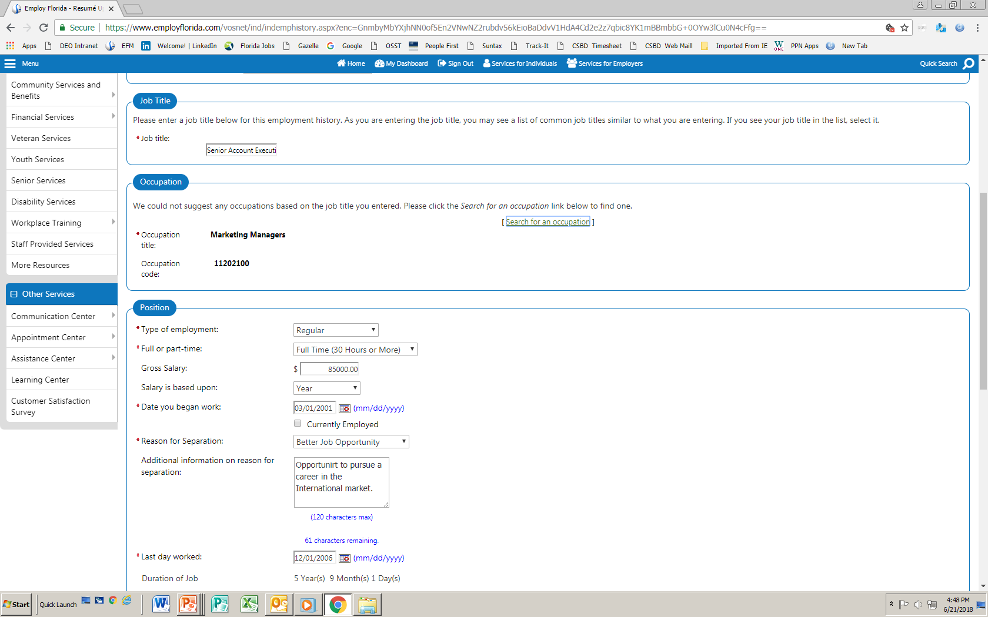
Employment (cont.)
Menu
Home
]
Sign Out
Services for Individuals
My Dashboard
Services for Employers
Job Title
Please enter a job title below for this employment history. As you are entering the job title, you may see a list of common job titles similar to what you are
* Job Title:
Senior Account Executive
Occupation
We could not suggest any occupations based on the job title you entered. Please click the Search for an occupation link below to find one.
* Occupation Title:
Marketing Managers
[ Search for an occupation ]
* Occupation Code:
11202100
Complete the Job Title, Occupation Title, Occupation Code, and Position information.
Position
* Type of employment:
Regular
* Full or part-time:
Full-time (30 Hours or More)
$
85,000.00
Gross Salary:
Salary is based upon:
Year
* Date you began work:
03/01/2001
(mm/yyyy)
Currently Employed
* Reason for Separation:
Better Job Opportunity
Page 2
www.careersourcebroward.com
Notes:
ef

Slide 37
Employment History
Menu
Home
]
Sign Out
Services for Individuals
My Dashboard
Services for Employers
Employment History
Employer
Location
Start / End Dates
Actions
Edit | Delete
Fidelity Capital Financial Group
Pompano Beach, FL
11/2010 – 02/2018
Edit | Delete
Florida Joint Title Plant
Fort Lauderdale, FL
02/2007 – 09/2010
Edit | Delete
Worldwide Information Services
Fort Lauderdale, FL
03/2001 – 12/2006
Once all employment history is captured, it will be reflected in the table (as shown).
www.careersourcebroward.com
Notes:
ef

Slide 38
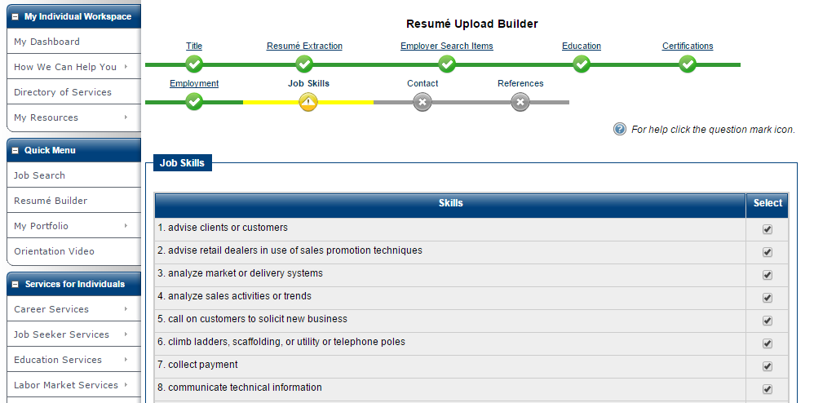
Job Skills
Building this skills database will increase the chances of potential employers finding your résumé faster. Skill information must be manually entered into the system in the Job Skills category.
Page 2
www.careersourcebroward.com
Notes:
ef

Slide 39
Contact
Menu
Home
]
Sign Out
Services for Individuals
My Dashboard
Services for Employers
Résumé Upload Builder
Title
Résumé Extraction
Employer Search Items
Education
Certifications
Employment
Job Skills
Contact information must be correct for potential employers to communicate with the User about opportunities.







Ability Summary
Objective
Honors & Activities
Additional Information
Contact
References




* Indicates required field
Active Confidential
Name
* First Name
Tom
ML:
* Last Name
Fabricator
.
Residential Address
Are you homeless?
Yes
No
* Address Line 1:
* Address Line 2:
* Zip Code:
Find zip code
* Country:
United States:
* City:
39
www.careersourcebroward.com
Page 2
Page 2
Notes:
ef

Slide 40
References
Menu
Home
]
Sign Out
Services for Individuals
My Dashboard
Services for Employers
Résumé Upload Builder
Details about References (contacts who can refer you for jobs) are optional. Enter your references and click Finish.
Title
Résumé Extraction
Employer Search Items
Education
Certifications
Employment
Job Skills







Ability Summary
Objective
Honors & Activities
Additional Information
Contact
References





* Indicates required field
Active Confidential
Detailed References
Name
Phone
Employer
Reference Type
You have no records
Display “References available on request” on this résumé
[ Add a new Reference ]
<< Back
Finish
40
www.careersourcebroward.com
Notes:
ef

Slide 41
Your Résumé on Employ Florida
Menu
Home
]
Sign Out
Services for Individuals
My Dashboard
Services for Employers
Here is your completed résumé. To modify a section, click on a Section Title (e.g. Employment History)
Please review your résumé for accuracy before clicking the save button at the bottom of the screen.
?
For help click the question mark icon
Résumé ID
Résumé Title
Résumé Score
Accessibility
6429521
Manager Sales & Marketing
85
Online
Create Date 6/20/2018 11:52:42 AM
Last Time Modified 6/22/2018 10:25:00 AM
Attached Résumé
View your attached résumé
Replace Document
Your résumé can be viewed in MS Word and printed by clicking on the View your Attached Résumé link.
You cannot edit the résumé in Employ Florida.
You can replace the résumé with a new résumé by selecting the Replace Document link.
The uploaded résumé remains on-line for six months. The résumé may be extended for another six months by selecting the résumé and re-saving it.
Page 2
www.careersourcebroward.com
Notes:
ef

Slide 42
Employ Florida
Using the Job Search
Page 2
www.careersourcebroward.com
Notes:
ef

Slide 43
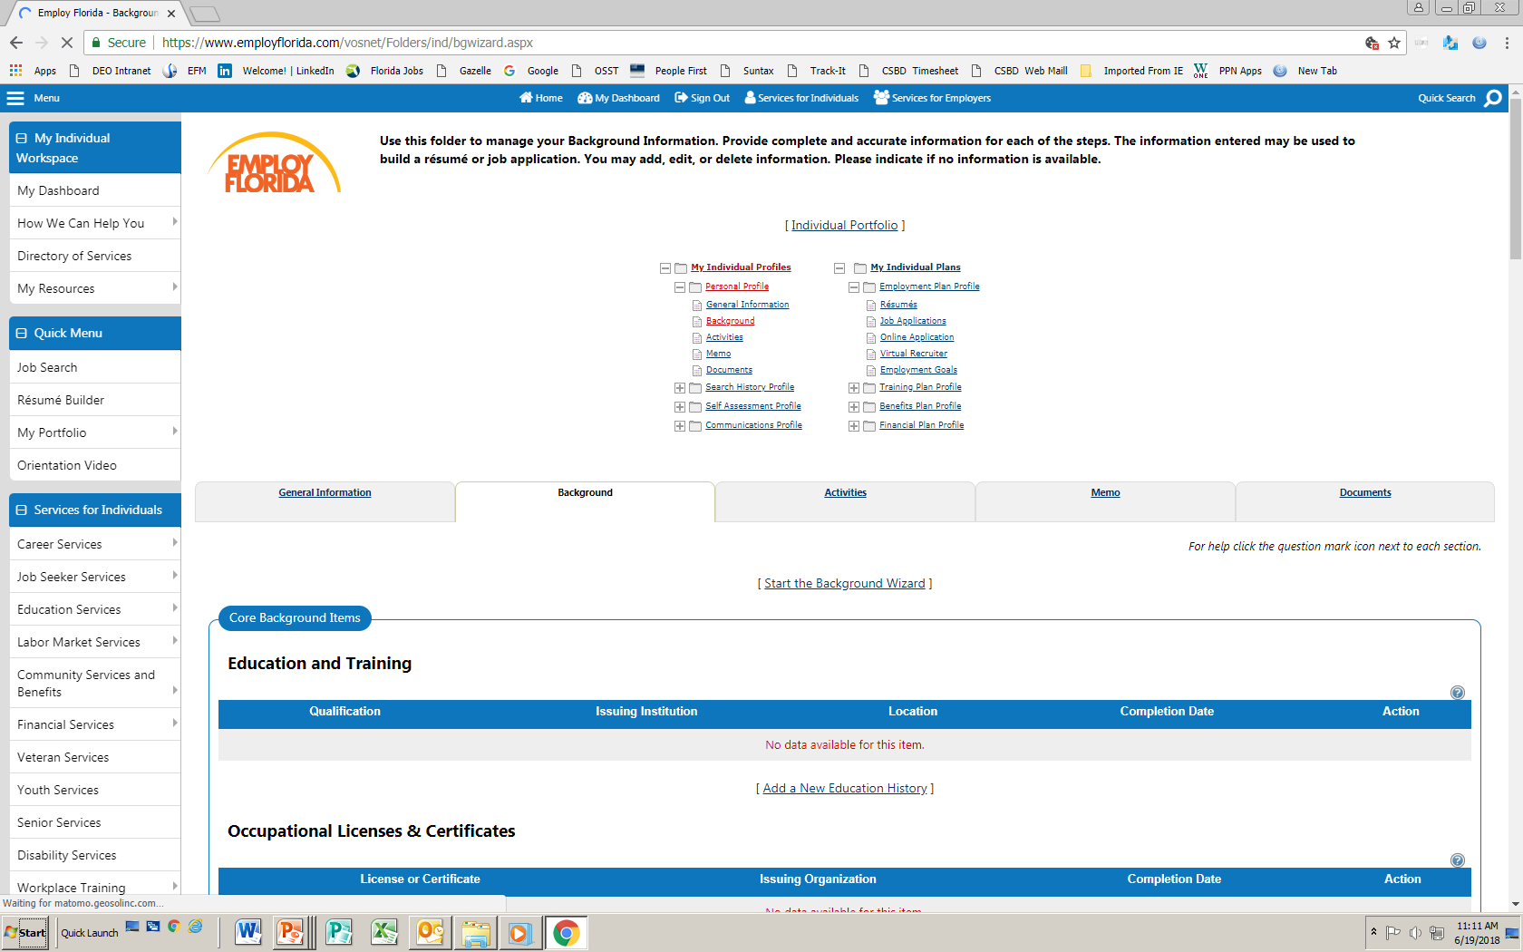
Background
Menu
Home
]
Sign Out
Services for Individuals
My Dashboard
Services for Employers
Use this folder to manage your Background Information. Provide complete and accurate info
build a résumé or job application. You may add, delete or edit information. Please indicate if n
[Individual Portfolio]
Before starting a job search, click on My Portfolio in the Quick Menu. Then select the Background tab.
My Individual Profiles
My Individual Plans
Personal Profile
Employment Plan Profile
General Information
Résumés
Background
Job Applications
Activities
Online Application
Memo
Virtual Recruiter
Documents
Employment Goals
Search History Profile
Training Plan Profile
Self Assessment Profile
Benefits Plan Profile
Communications Profile
Financial Plan Profile
Job Search
General Information
Background
Activities
Résumé Builder
[Start the Background Wizard]
My Portfolio
Core Background Items
Education and Training
Qualifications
Issuing Institution
Location
No data available for this item.
Occupational licenses & certificates
[Add a new education history]
Notes:
ef

Slide 44
Background
Use the Background folder to manage your Background Information, including:
Education & Training
Occupational Licenses & Certificates
Employment History
Job Skills
Tools & Technology
Ability Summary
Honors & Awards
Detailed References
Desired Occupation(s)
Desired Job Type
Desired Location
Desired Salary
Driver’s License Information
Languages & Proficiency
Page 2
www.careersourcebroward.com
Notes:
ef

Slide 45
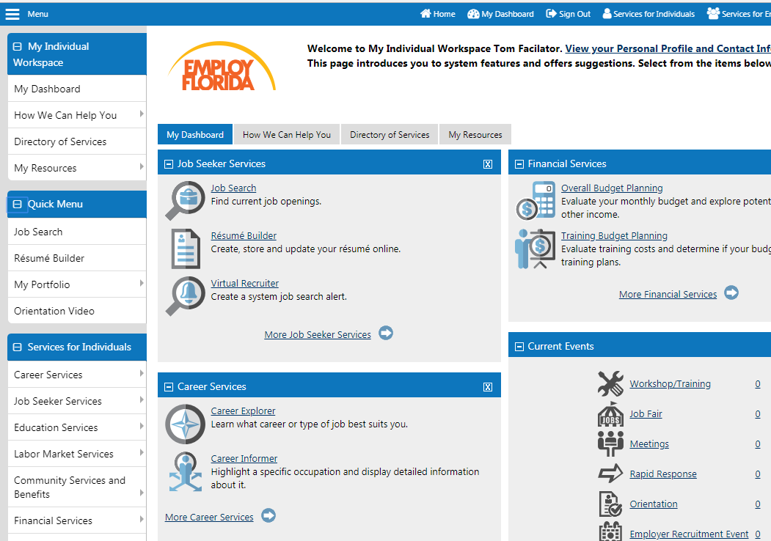
Searching for a Job in Employ Florida
After filling in the Background, the User may begin by selecting Job Search from either the Quick Menu or from Job Seeker Services .
Page 2
www.careersourcebroward.com
Notes:
ef

Slide 46
Quick Job Search
Menu
Home
]
Sign Out
Services for Individuals
My Dashboard
Services for Employers
Please choose one of the methods below to view available job openings in the area you selected. To create an automated job search (virtual recruiter), select criteria below, perform the search and then save your search at the bottom of the results screen.
WARNING: Always be on the lookout for job scams! Learn more on how to protect yourself against online scams and identity theft.
?
For help click the question mark icon
Your most recent job search took place on Friday, August 10
Execute a saved job search/Virtual Recruiter
Quick Job Search lets you choose a Area (place) and Key Words (Job Title).
The Key Word may produce a number of job results.
Next, click on Search.
Quick Job Search
Advanced Job Search
Job Search by Employer
Job Search by Education
Job Search by Skills
Job Search by Résumé Criteria
Job Number Search
You may enter any combination of search criteria below. When you have completed entering your search criteria information, click the Search button/link.
[ Search ]
Search Criteria
Area (Click to change):
Broward County, FL
Key Words (e.g. Accountant):
Marketing Manager
Marketing Manager (9 jobs)
Integrated Marketing Manager – CBS Sports.com (2 jobs)
Marketing Manager – Sabel Marketing Campaign (2 jobs)
+ Show additional quick search
Are you a veteran and wish to enter your military occupation?
Search
Other Job Sites
Jobs outside of Florida
www.careersourcebroward.com
Notes:
ef

Slide 47
Job Search Results
Menu
Home
]
Sign Out
Services for Individuals
Services for Employers
My Dashboard
Here is a list of job openings in Broward County that meet your search criteria. Click on a job title to see more information about the job.
WARNING: Always be on the lookout for job scams! Learn more on how to protect yourself against online scams and identity theft.
Your job search found 45 job(s), representing at least 45 positions, that matched your search criteria. Change your search criteria - Save this Job search.
Results view: Summary l Detailed
?
For help click the question mark icon
To sort on any column, click a column title
Hide potential duplicate jobs
Date Last Modified
Job Title / Description Snippet
Employer
Location
Job Skills
General
Specialized
Salary
Source
Key Match
Select
06/21/2018 1:01:00 PM
Marketing Manager
Basilo Appliances, Repair and Home Installation Corp.
Pompano Beach, FL
100%
70%
Yes
$38,314.00 per year
1
This position develops marketing policies and programs such as determining the demand for products and services offered by a firm and its competitors, and identify potential customers..
06/18/2018 10:06:00 AM
Marketing Manager
Cyclone Technologies, Inc..
Davie, FL
$75,000.00 to $90,000.00 per year
1
100%
85%
N/A
CORP
This is a hands on position. If you are a take-charge change agent with proven leadership skills who thrives in a fast-paced and ever changing environment then you need to apply for this job.
Important information about each job match is presented in the table. Click on the Job Title for more information or to apply for that job.
www.careersourcebroward.com
Page 2
Notes:
ef

Slide 48

Apply Using an Employ Florida Online résumé
Applying for this position requires the User to have their résumé loaded in Employ Florida. Click on Apply via Résumé to submit the résumé to the employer.
Menu
Home
]
Sign Out
Services for Individuals
Services for Employers
My Dashboard
Please follow the instructions on this page to apply for the job you’ve selected.
WARNING: Always be on the lookout for job scams! Learn more
[ Print view ]
Job Order Number 10722856
Company Basilo Appliances, Repair and Home Installation, Corp.
Job Title Marketing Manager
To apply you must be a US Citizen and have authorization to work in the United States. If you are not a US Citizen and qualify for employment in the US, please indicate the type of authorization you have. To apply, click on the bottom of your preferred application method under one of the options below.
Apply using an Employ Florida Online résumé
The employer requests you submit an online résumé. You must attach one of your résumé(s) for the employer to review.
Apply via Résumé
Page 2
www.careersourcebroward.com
Notes:
ef

Slide 49
Apply Using an Employ Florida Online résumé
Menu
Home
]
Sign Out
Services for Individuals
Services for Employers
My Dashboard
This confirmation message shows that the résumé has been submitted to the employer through Employ Florida.
Please review your information below regarding your submission.
Job Order Number 10722856
Company Basilo Appliances, Repair and Home Installation, Corp.
Job Title Marketing Manager
Apply using an Employ Florida Online résumé
Thank you for your submission. Below is a summary of what information was submitted as well as follow up information required to complete your application to the job.
You have applied via résumé on 06/21/2018 1:01 PM
You have submitted a résumé named Manager Sales & Marketing ( view )
Page 2
www.careersourcebroward.com
Notes:
ef

Slide 50
Types of Jobs in Employ Florida
There are two main types of jobs on Employ Florida:
Preferred Jobs
    These jobs were developed through CareerSource Broward and created by Employers who are currently working closely with Employ Florida.
All other Jobs
    These are jobs from other sources on the Internet, such as private job boards, corporate job boards, other state job boards, and federal job boards.
    You may need to register on those external sites in order to apply to those jobs.
Page 2
www.careersourcebroward.com
Notes:
ef

Slide 51
Preferred Jobs in Employ Florida
Preferred Jobs are divided into two types:
Unsuppressed Jobs
    These jobs are open to all job seekers. You can apply to these positions without a referral from CareerSource Broward.
Suppressed Jobs
    These jobs require a referral from a CareerSource Broward counselor.
      A counselor will contact you to go over your qualifications for the position once you Click → on the Please have a staff person contact me button.
      Take the Job Order Number of the job which you are interested in to the Front Desk of a CareerSource Broward Career Center to begin the referral process.
Page 2
www.careersourcebroward.com
Notes:
ef

Slide 52
Other Job Search Options
Menu
Home
]
Sign Out
Services for Individuals
My Dashboard
Services for Employers
Please choose one of the methods below to view available job openings in the area you selected. To create an automated job search (virtual recruiter), select criteria below, perform the search and then save your search at the bottom of the results screen.
WARNING: Always be on the lookout for job scams! Learn more on how to protect yourself against online scams and identity theft.
?
For help click the question mark icon
Your most recent job search took place on Friday, August 10
Execute a saved job search/Virtual Recruiter
Quick Job Search
Advanced Job Search
Job Search by Employer
Job Search by Education
Job Search by Skills
Job Search by Résumé Criteria
Job Number Search
You may enter any combination of search criteria below. When you have completed entering your search criteria information, click the Search button/link.
[ Search ]
You may also do an Advanced Job Search, which lets you enter specific search criteria.
Additionally, you may search by Employer, Education, Skills, Résumé Criteria, or Job Number.
www.careersourcebroward.com
Notes:
ef

Slide 53
Employ Florida
Using the Virtual Recruiter
Page 2
www.careersourcebroward.com
Notes:
ef

Slide 54
Employ Florida Virtual Recruiter
The Virtual Recruiter allows Employ Florida to search for a new job for you!
Create and save automated job searches
Specify how often job searches will run
Receive messages from Virtual Recruiter when a new job match is found
Matches can be delivered to your Employ Florida inbox, to your e-mail address, to your phone by text, or by all three methods.
Page 2
www.careersourcebroward.com
Notes:
ef

Slide 55

Virtual Recruiter
The User can access the Virtual Recruiter in the Job Seeker Services tab.
Page 2
www.careersourcebroward.com
Notes:
ef

Slide 56
Creating a Job Alert
Menu
Home
]
Sign Out
Services for Individuals
My Dashboard
Services for Employers
Use this folder to manager your Job Saved Alerts. Click the Create New Job Alert button to select a recurring search for jobs that match your requirements. On your next screen, you will need to enter search criteria and Click search. Scroll down to the bottom of the page and click Save Search. This will save your job search and automatically run it on the schedule you select.
[Individual Portfolio]
My Individual Profiles
My Individual Plans
Personal Profile
Employment Plan Profile
General Information
Résumés
Background
Job Applications
Activities
Online Application
Memo
Virtual Recruiter
Documents
Employment Goals
Search History Profile
Training Plan Profile
Self Assessment Profile
Benefits Plan Profile
Communications Profile
Financial Plan Profile
Résumés
Job Application
Online Application
Virtual Recruiter
Employment Goals
With no previous Job Alerts, this page will show “0 Records Found.” To begin the Job Alerts process, click on Create new Job Alert.
?
For help click the question mark icon
0 Records Found
Create new Job Alert
Page 2
www.careersourcebroward.com
Notes:
ef

Slide 57
Search Criteria for a Job Alert
Menu
Home
]
Sign Out
Services for Individuals
My Dashboard
Services for Employers
Please choose one of the methods below to view available job openings in the area you selected. To create an automated job search (virtual recruiter), select criteria below, perform the search and then save your search at the bottom of the results screen.
WARNING: Always be on the lookout for job scams! Learn more on how to protect yourself against online scams and identity theft.
?
For help click the question mark icon
To create a Job Alert, first choose the Area (location), Key Words (Job Title), and then select Search.
Here are your most recently selected jobs: Marketing Manager: Integrated Marketing Manager: Design Marketing Manager
Execute a saved job search/Virtual Recruiter
Quick Job Search
Advanced Job Search
Job Search by Employer
Job Search by Education
Job Search by Skills
Job Search by Résumé Criteria
Job Number Search
You may enter any combination of search criteria below. When you have completed entering your search criteria information, click the Search button/link.
Search Criteria
[ Search ]
Area (Click to change):
Broward County, FL
Key Words (e.g. Accountant):
Marketing Manager
+ Show Keyword search Options
+ Show Additional Quick Search Options
To create a new Virtual Recruiter job alert please enter your job search criteria in the Keywords text box above and click the search button. You will then be presented with a list of jobs. Click on the Save search button at the bottom of the next screen to set up your new job alert and enter key parameters such as the alert name and how often it will run.
Search
Page 2
www.careersourcebroward.com
Notes:
ef

Slide 58
Search Results for a Job Alert
Menu
Home
]
Sign Out
Services for Individuals
Services for Employers
My Dashboard
Here is a list of job openings in Broward County that meet your search criteria. Click on a job title to see more information about the job.
WARNING: Always be on the lookout for job scams! Learn more on how to protect yourself against online scams and identity theft.
Your job search found 45 job(s), representing at least 45 positions, that matched your search criteria. Change your search criteria - Save this Job search.
Results view: Summary l Detailed
?
For help click the question mark icon
To sort on any column, click a column title
Hide potential duplicate jobs
Date Last Modified
Job Title / Description Snippet
Employer
Location
Job Skills
General
Specialized
Salary
Source
Key Match
Select
06/21/2018 1:01:00 PM
Marketing Manager
Basilo Appliances, Repair and Home Installation Corp.
Pompano Beach, FL
100%
70%
Yes
$38,314.00 per year
1
This position develops marketing policies and programs such as determining the demand for products and services offered by a firm and its competitors, and identify potential customers..
06/18/2018 10:06:00 AM
Marketing Manager
Cyclone Technologies, Inc..
Davie, FL
$75,000.00 to $90,000.00 per year
1
100%
85%
N/A
CORP
This is a hands on position. If you are a take-charge change agent with proven leadership skills who thrives in a fast-paced and ever changing environment then you need to apply for this job.
The User will be presented with a list of jobs
to possibly add to the Job Alert.
Page 2
www.careersourcebroward.com
Notes:
ef

Slide 59

Virtual Recruiter Information
Menu
Home
]
Sign Out
Services for Individuals
My Dashboard
Services for Employers
Please provide the information outlined below
Enter key information: Title of Virtual Recruiter Alert, How often to run, Notification Method, and Expires on Date.
Then click Save.
* Indicates required field
For help click the question mark icon next to each section
Virtual Recruiter Information
Sales Managers
?
* Title of Virtual Recruiter Alert:
Marketing Alert
* How often to run:
Daily
* Notification Method
Message Center
Email
Send Email when no jobs found
* Expires on:
11/15/2018
Last modified on:
Search Criteria Information
Broward County
?
Location:
Keyword:
Marketing Manager
Field of Search:
job title, job description
Source(s):
Private job board, Corporate, Education Institutions, State job board, Government,
Save
Cancel
Select another job seeker service
www.careersourcebroward.com
Notes:
ef

Slide 60
Running the Virtual Recruiter
Menu
Home
]
Sign Out
Services for Individuals
My Dashboard
Services for Employers
Use this folder to manager your Job Saved Alerts. Click the Create New Job Alert button to select a recurring search for jobs that match your requirements. On your next screen, you will need to enter search criteria and Click search. Scroll down to the bottom of the page and click Save Search. This will save your job search and automatically run it on the schedule you select.
[Individual Portfolio]
The Virtual Recruiter is now active and will start when you click Run.
My Individual Profiles
My Individual Plans
Personal Profile
Employment Plan Profile
General Information
Résumés
Background
Job Applications
Activities
Online Application
Memo
Virtual Recruiter
Documents
Employment Goals
Search History Profile
Training Plan Profile
Self Assessment Profile
Benefits Plan Profile
Communications Profile
Financial Plan Profile
Résumés
Job Application
Online Application
Virtual Recruiter
Employment Goals
To sort on any column, click a column title
?
For help click the question mark icon
Title
Expires
Schedule
Next Run
Notification
Action
Select
Marketing Alert
11/15/2018
Daily
6/23/2018
Manage Center, Email
Run
Delete
1
1
Rows
25
of
Page
1 Records Found
Page 2
www.careersourcebroward.com
Notes:
ef

Slide 61
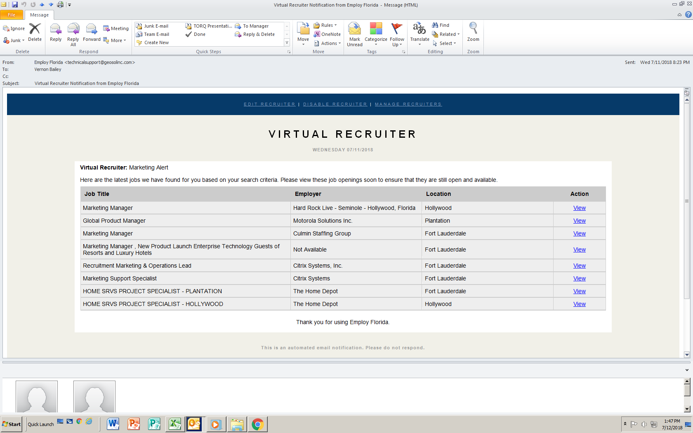
Virtual Recruiter Results
This is a sample Virtual Recruiter report.
Page 2
www.careersourcebroward.com
Notes:
ef

Slide 62
Employ Florida Dashboard
There are many other useful features on your Employ Florida Dashboard. See what you find!
Page 2
www.careersourcebroward.com
Notes:
ef

Slide 63
Expanding Your Job Search
A number of additional resources are available online to assist you in finding your next position:
Search Engines (www.google.com)
Google Alerts (www.google.com/alerts)
Government Websites (www.usajobs.gov)
Employer Websites (www.Target.jobs)
Job Search Engines (www.Monster.com)
Job Aggregators (www.indeed.com)
Page 2
www.careersourcebroward.com
Notes:
ef

Slide 64
CareerSource Broward
Don’t Forget to check out all of CareerSource Broward’s
Career Success Workshops
Additional Information maybe found at:
www.careersourcebroward.com
Page 2
www.careersourcebroward.com
Notes:
ef

