Slide 1

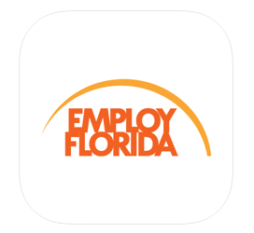
Employ Florida
Mobile:
a guide to the
Employ Florida app

Slide 2


Welcome! This is a brief guide to using the Employ Florida app for mobile devices.
Congratulations on your decision to utilize Employ Florida’s powerful job search tools.

Slide 3
This presentation will take approximately 30 minutes to read.
To get the most out of this presentation, it is recommended that you follow along with your mobile device.

Slide 4
To begin, locate the place on your mobile device where you normally find apps. Then download and install the “Employ Florida” app.

Slide 5
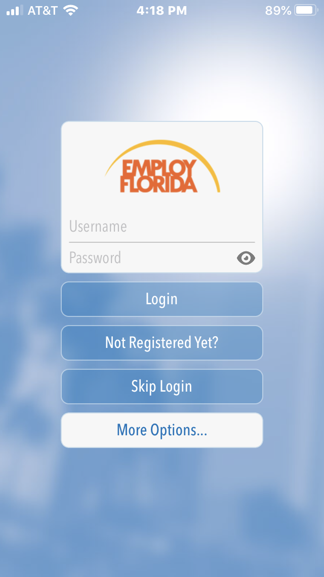
Opening
Screen
When you open the app, this is the screen you will see. You may use the app as a guest by choosing “Skip Login”.

Slide 6
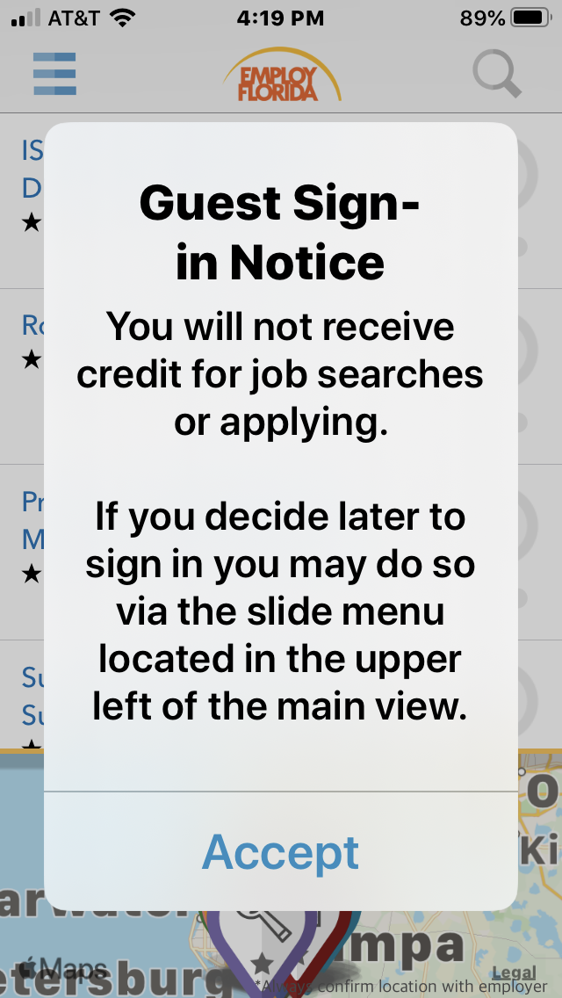
Guest Sign- in Notice
If you wish to use the app as a Guest, you must choose “Accept” after reading the terms.

Slide 7
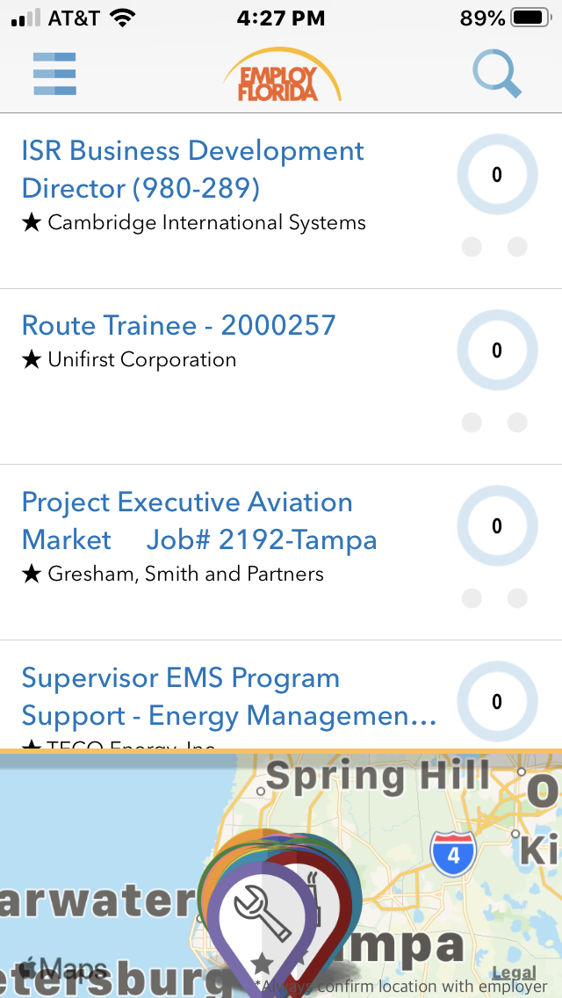
Job Search as Guest
As a guest, the app provides limited functions. For example, you will not be able to see how well you match a job’s requirements.

Slide 8
Opening
Screen
If you have already registered in Employ Florida, but you have forgotten your Username or Password, choose “More Options...”

Slide 9
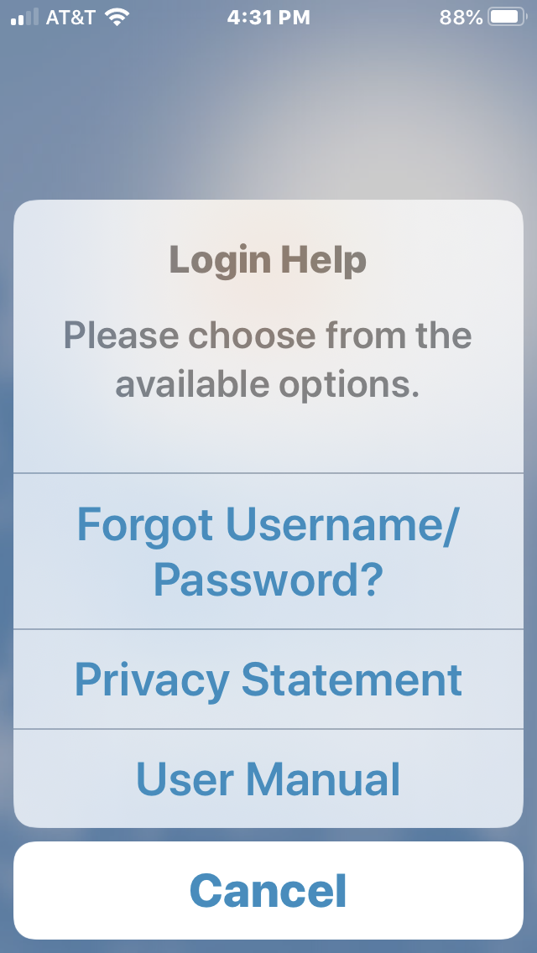
More
Options
Choosing “More Options” will assist you in recovering your Username and/or Password, read the Privacy Statement, or read the User Manual.

Slide 10
Opening
Screen
If you have not registered an account with Employ Florida, choose “Not Registered Yet?”

Slide 11
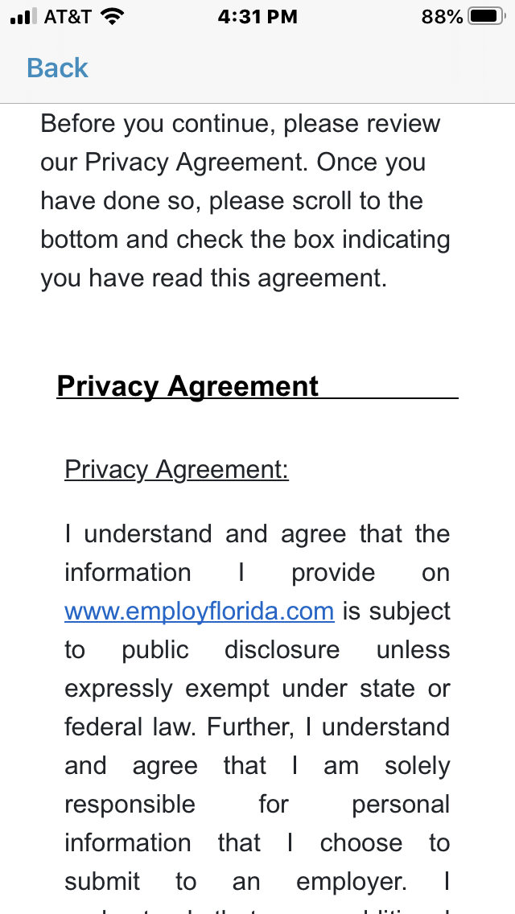
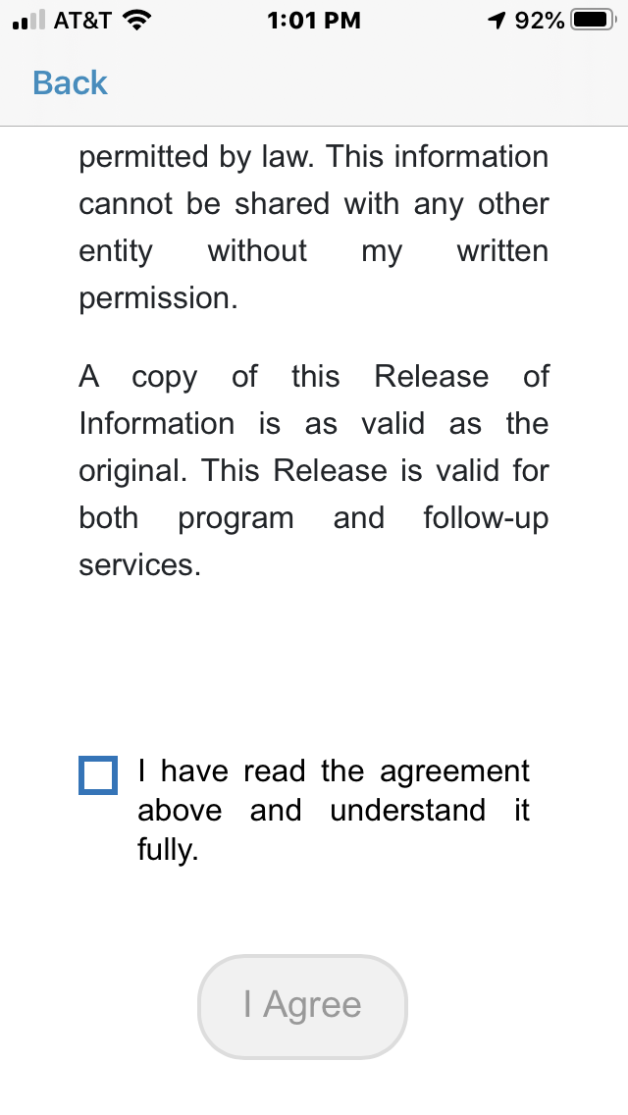
Privacy Agreement
Read through the agreement, check the box if you agree, and choose “I Agree.”

Slide 12
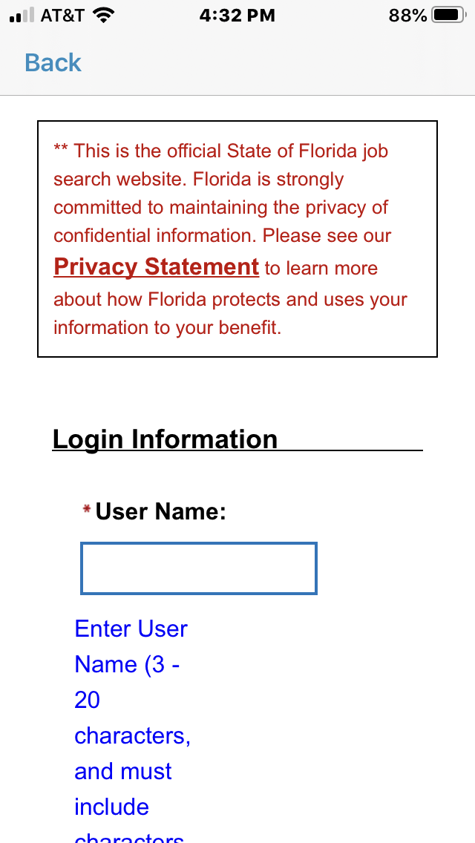
User Name
To register, select a User Name using the guidelines provided.

Slide 13
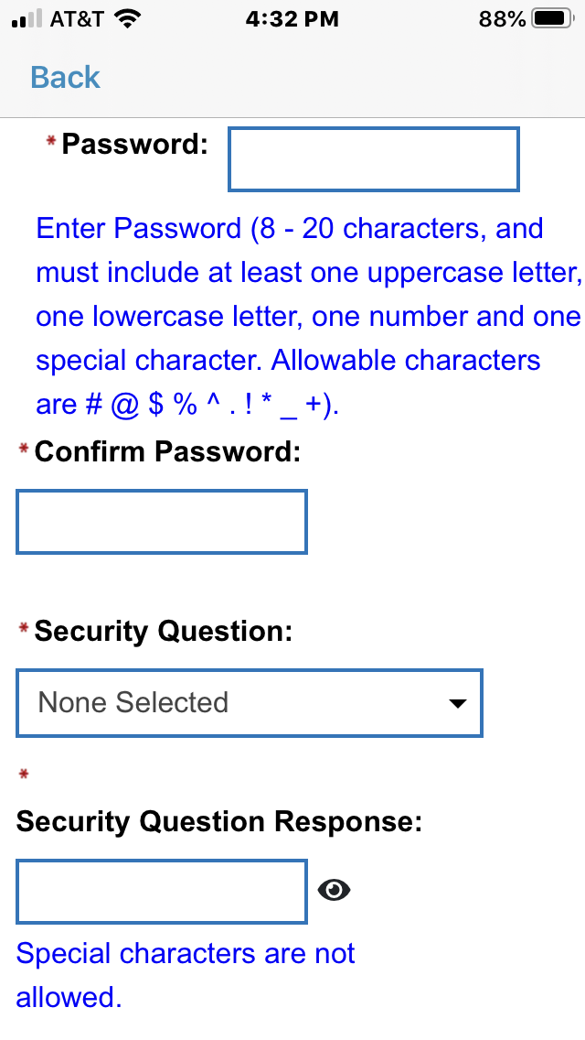
Password & Security Question
Select a Password using the guidelines provided, then confirm it.
Select a Security Question from the menu and enter your response.

Slide 14
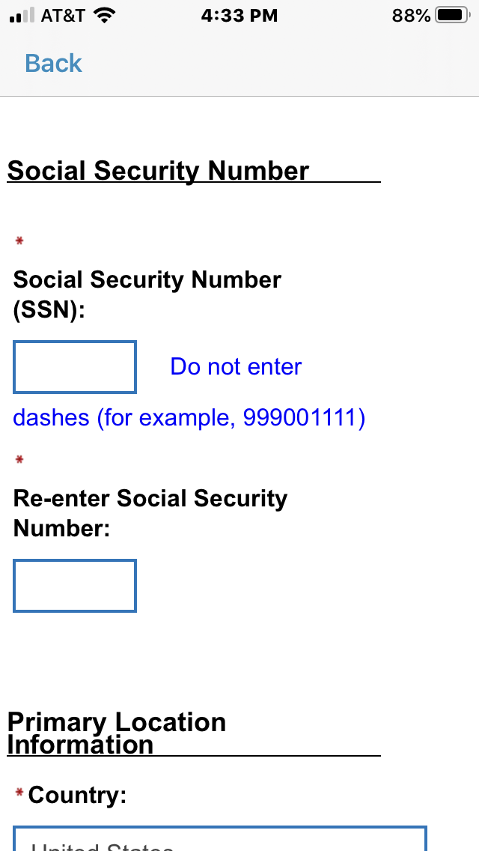
Social Security Number
Because Employ Florida is a state database, it asks you to enter and re-enter your SSN. The app states that your personal information is secure and encrypted.

Slide 15
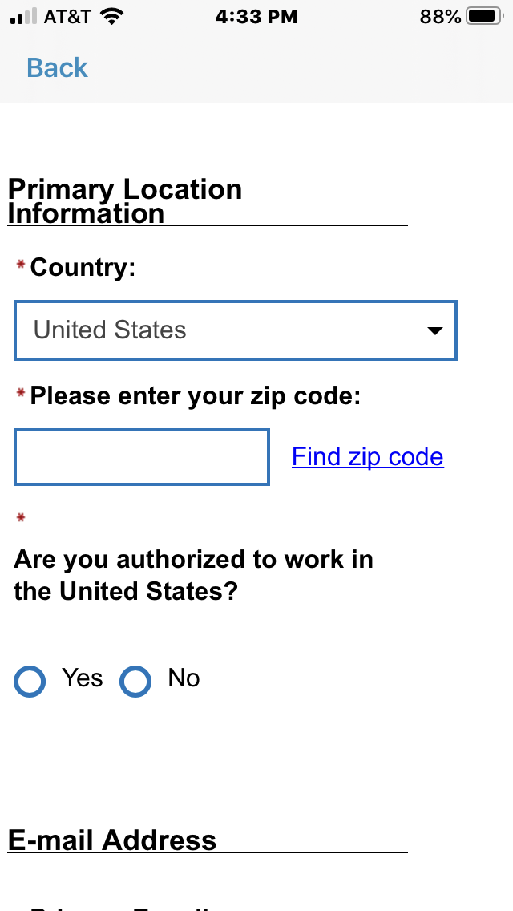
Location Information
Choose your country and enter your zip code. Mark whether you are authorized to work in the U.S.

Slide 16
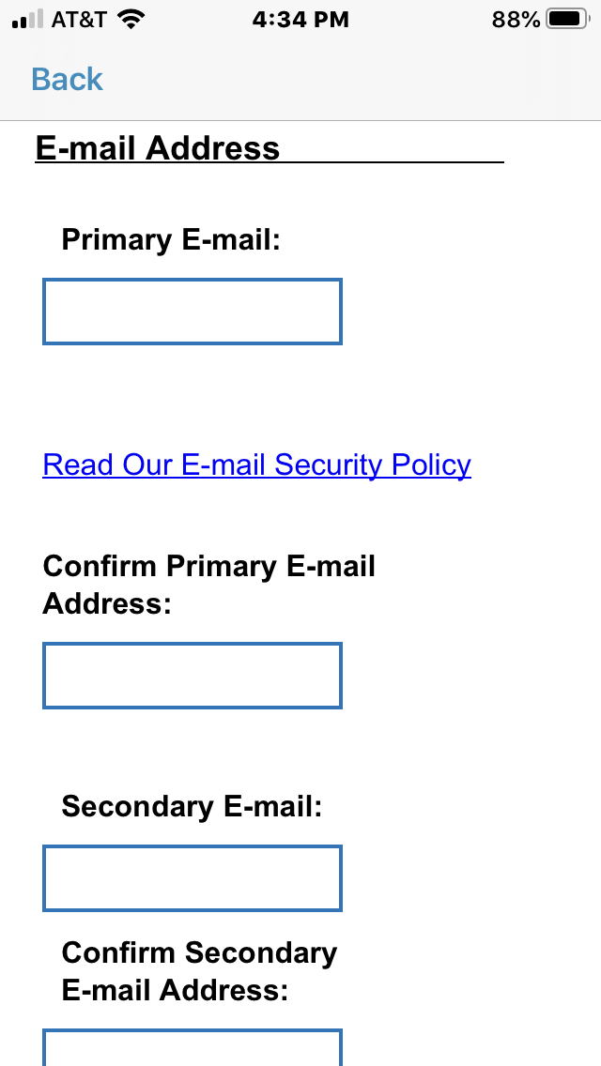
E-Mail Addresses
You must identify a working e-mail address and confirm it. You may also submit a secondary e-mail address.

Slide 17
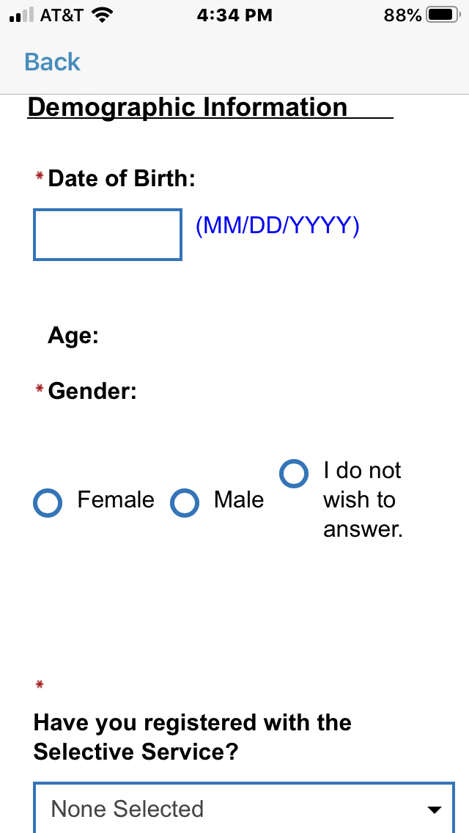
Demographic Information
Enter your Date of Birth in the format described, then choose from the options provided under Gender.

Slide 18
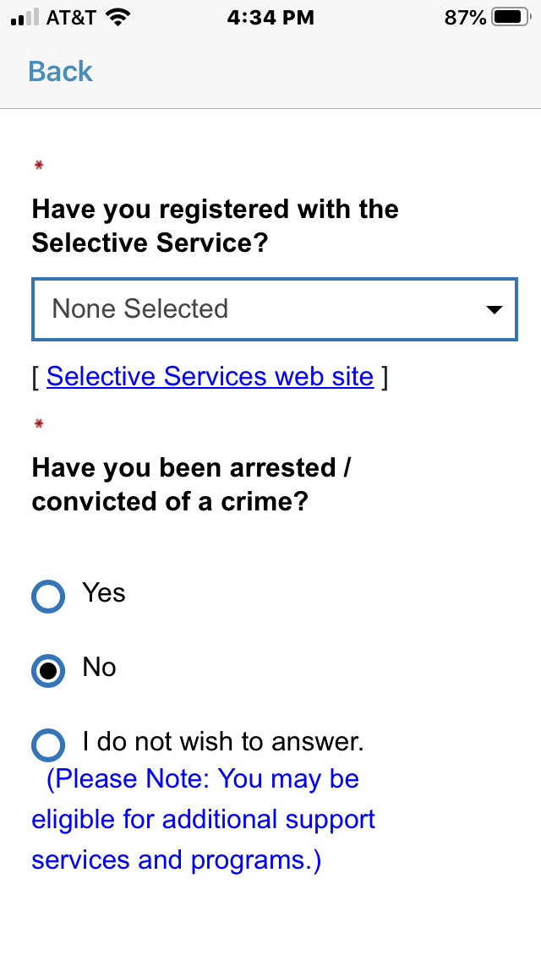
Selective Service & Record
Unless you selected “Female,” you must indicate if you have registered for Selective Service.
Select one of the responses to whether you have been arrested or convicted.

Slide 19
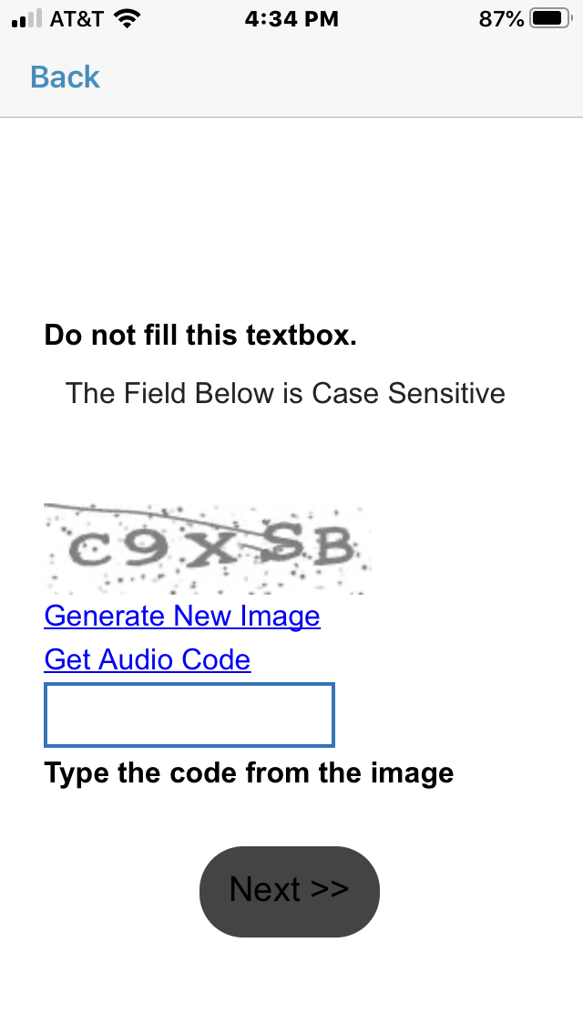
Verification Code
To verify your information, you will be asked to type the code you see in the box and choose “Next>>.”

Slide 20
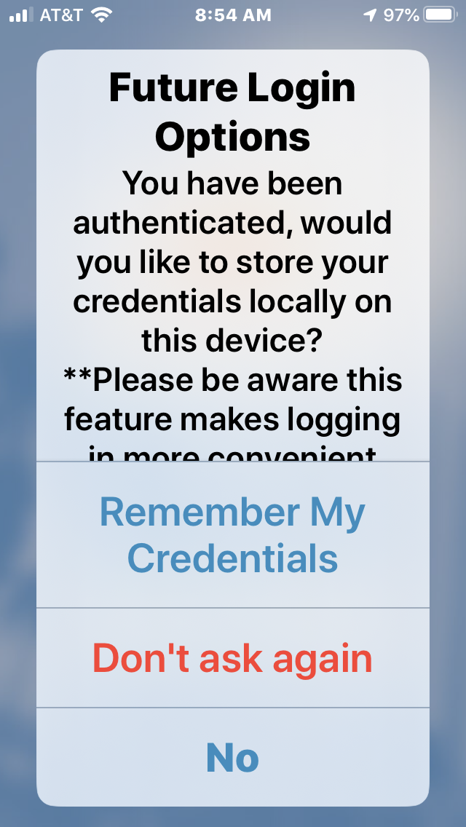
Future Login Options
Once you have successfully registered, you will be given the option to store your information, which makes logging in easier.

Slide 21
Opening
Screen
When you have registered in Employ Florida, you may enter your Username and Password. Then choose the “Login” option.

Slide 22
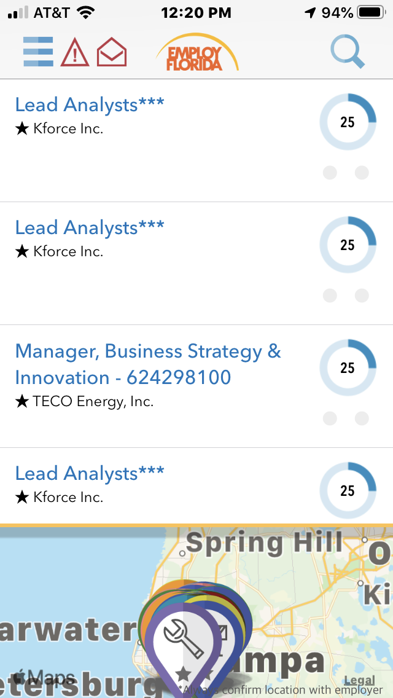
Default Screen
After you log in, you will be brought to a list of job openings. You can 1) explore these results, 2) do a Job Search, or
3) view the Menu. Let’s look at the Job Search function.
3
2
1

Slide 23
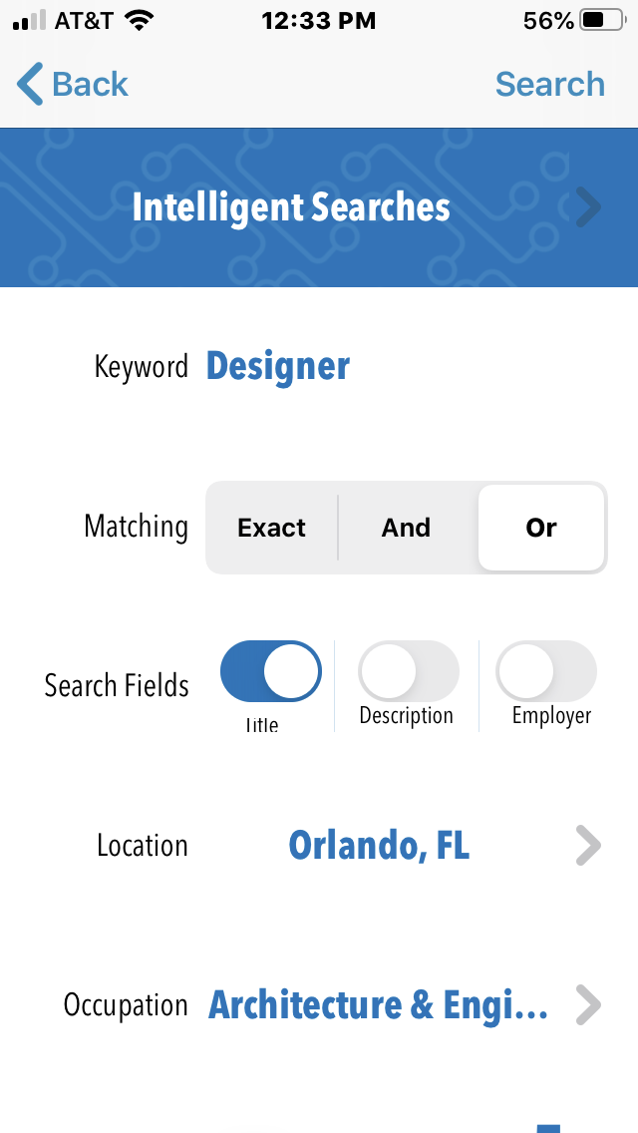
Job Searching
The “Intelligent Searches” feature lets you narrow your search by Keyword, Matching, Search Fields, Location, and Occupation.

Slide 24
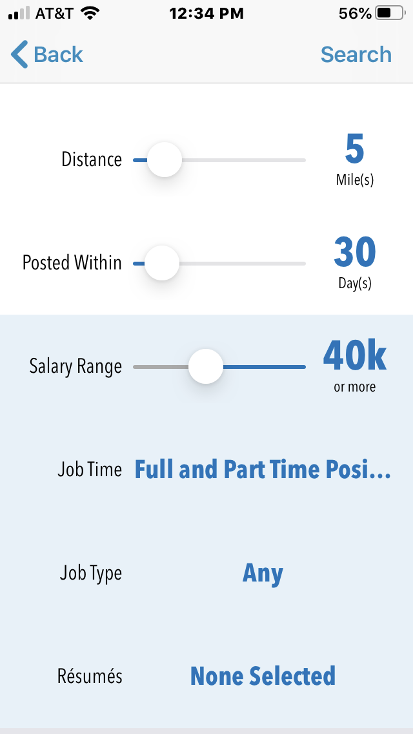
Job Searching
You may also narrow your search by Distance, Posted Within, Salary Range, Job Time, or Job Type.

Slide 25
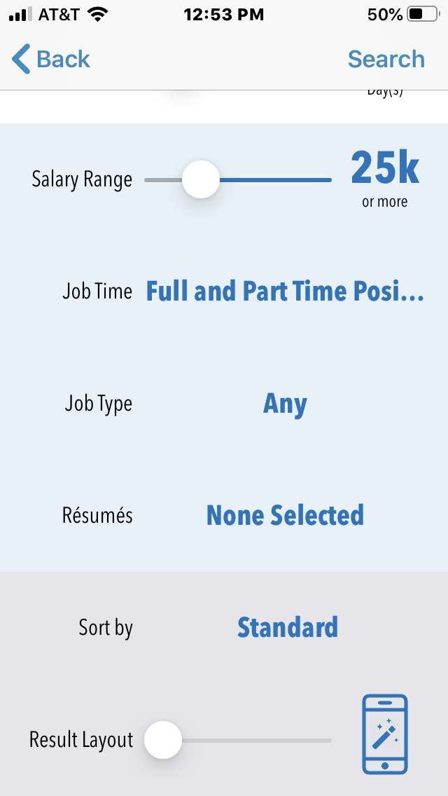
Job Searching
Other features include: Résumés, which lets you select your résumés; Sort by, which lets you choose a sorting category; and Result Layout, which shows your results in the style you prefer.

Slide 26
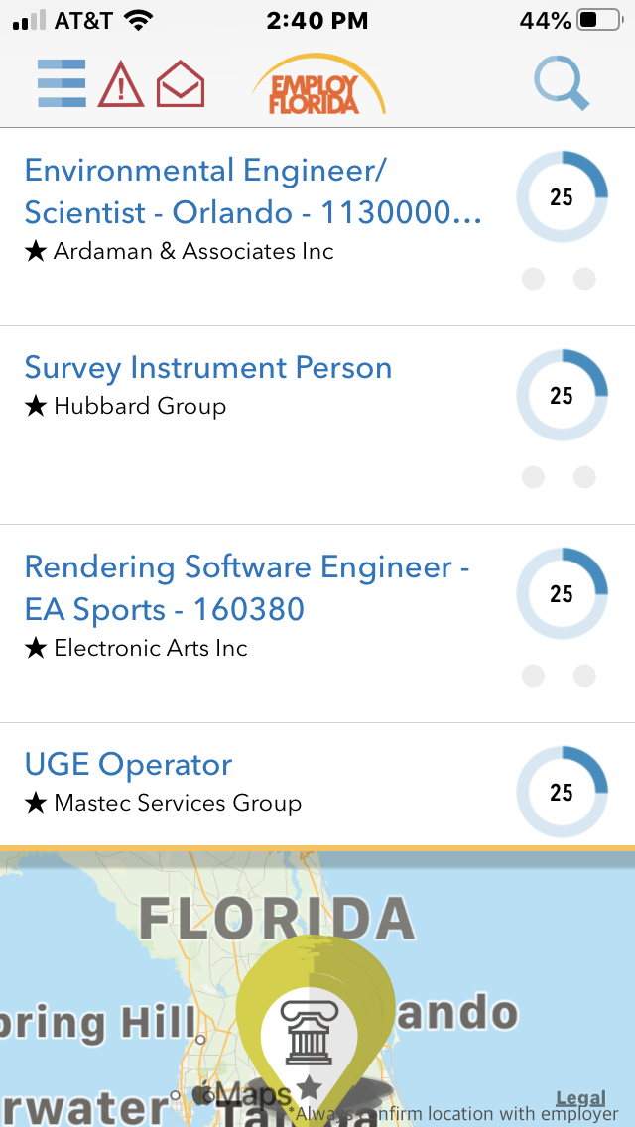
Search Results
This is an example of a search results screen. Select the job that interests you.

Slide 27
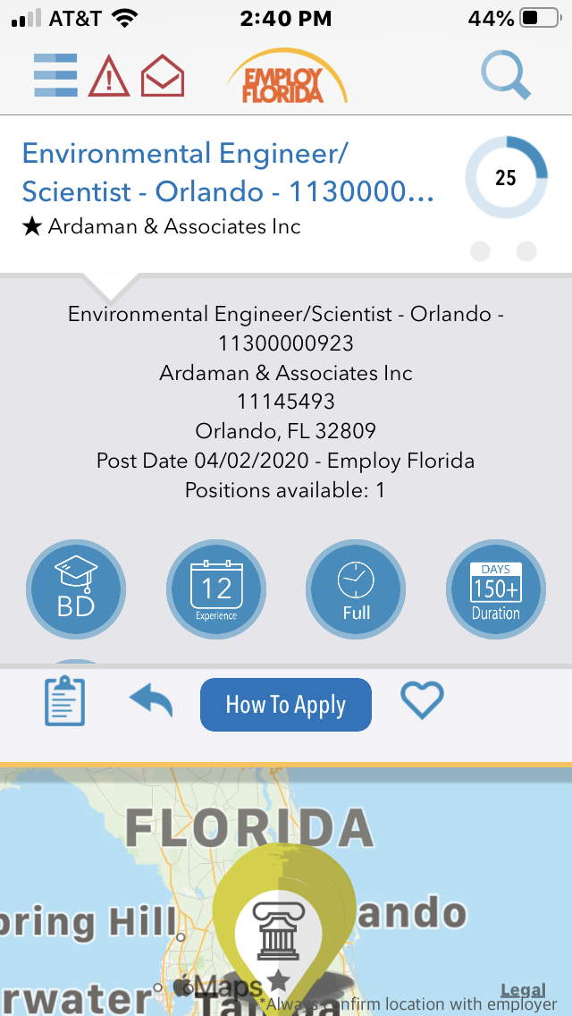
Job Posting
You will see information about the job, including required education, experience needed, the type of job, how long it has been posted, and where it is located.

Slide 28
Job Posting
The icons above the map let you 1) go to the Employer Research screen, 2) share the posting, 3) apply to the job, or 4) mark it as a “Favorite.”
1
2
3
4

Slide 29
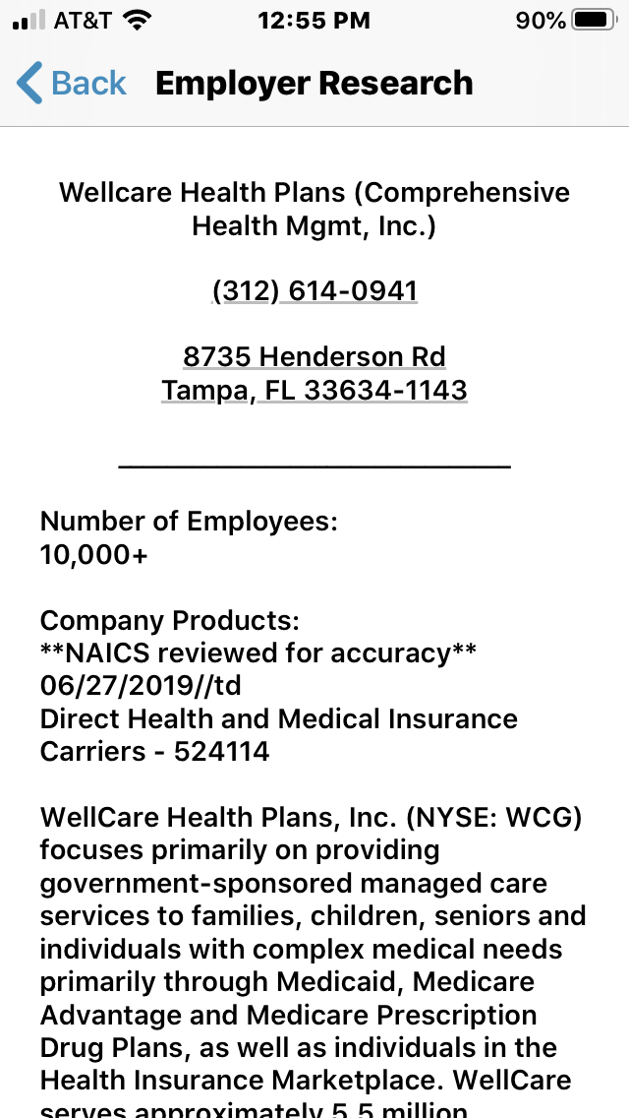
Employer Research
This resource lets you learn more information about the employer who posted the position.

Slide 30
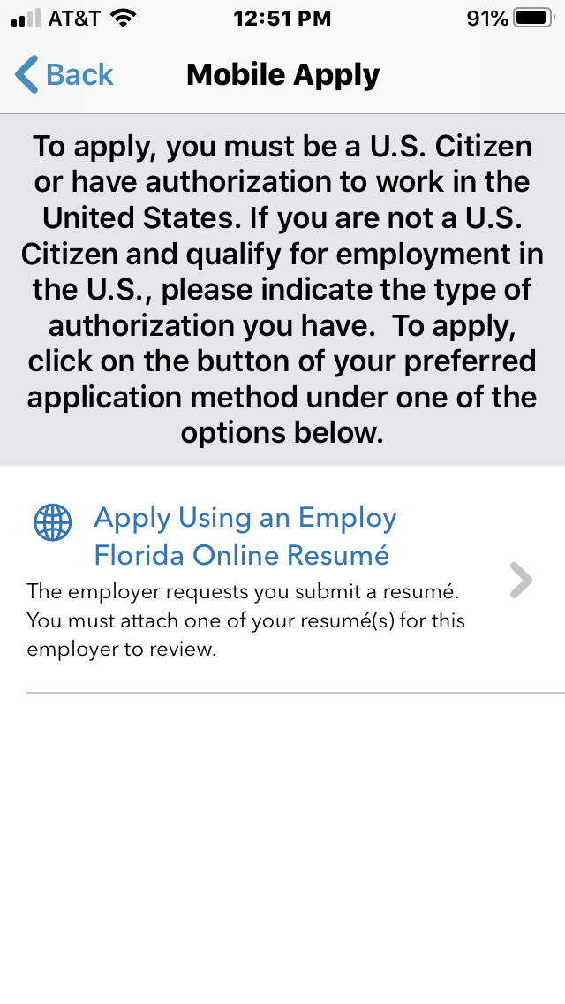
Mobile Apply
When you choose “How To Apply,” you will be shown the directions to apply for the job.

Slide 31
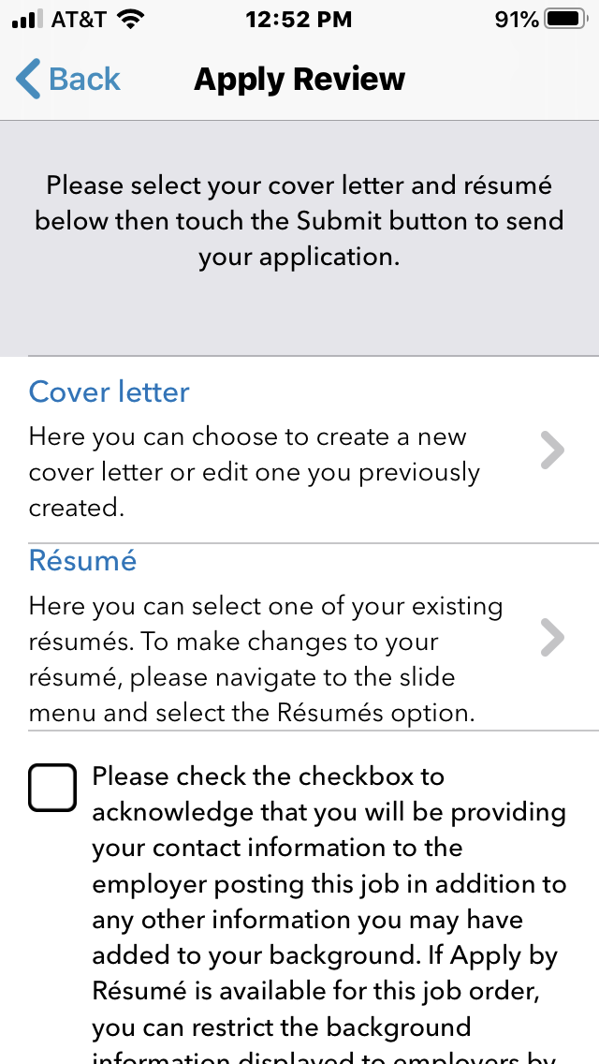
Apply Review
To apply, you can use one of the résumés you have saved in Employ Florida. If the job requires a Cover letter, choose that option also.

Slide 32
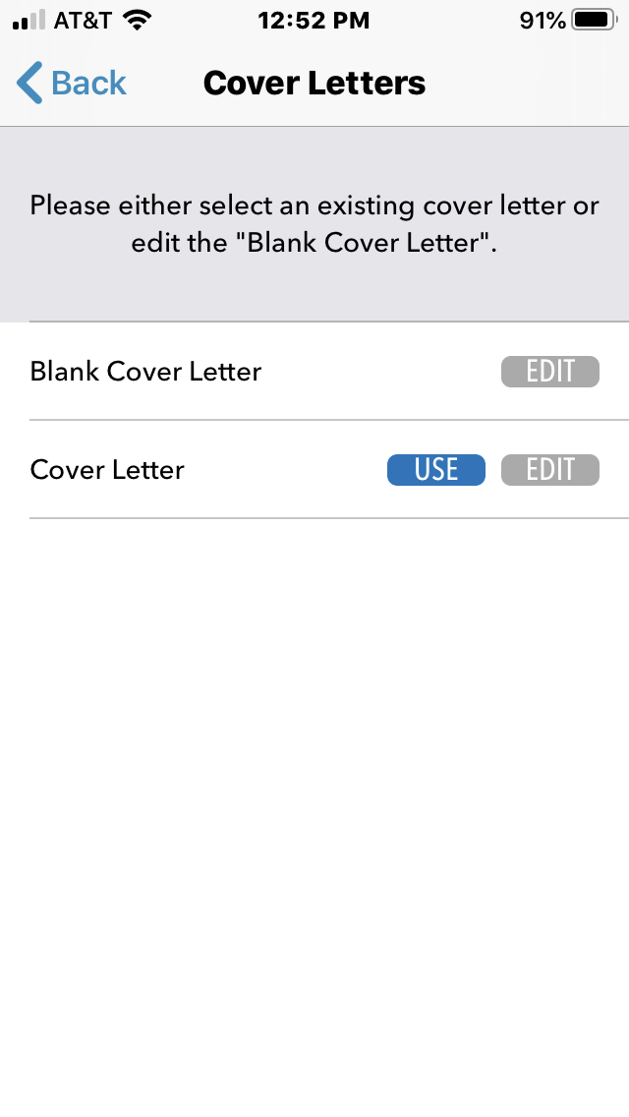
Cover Letters
You have the choice of using a Cover Letter already saved in Employ Florida or creating a new one with Blank Cover Letter.

Slide 33
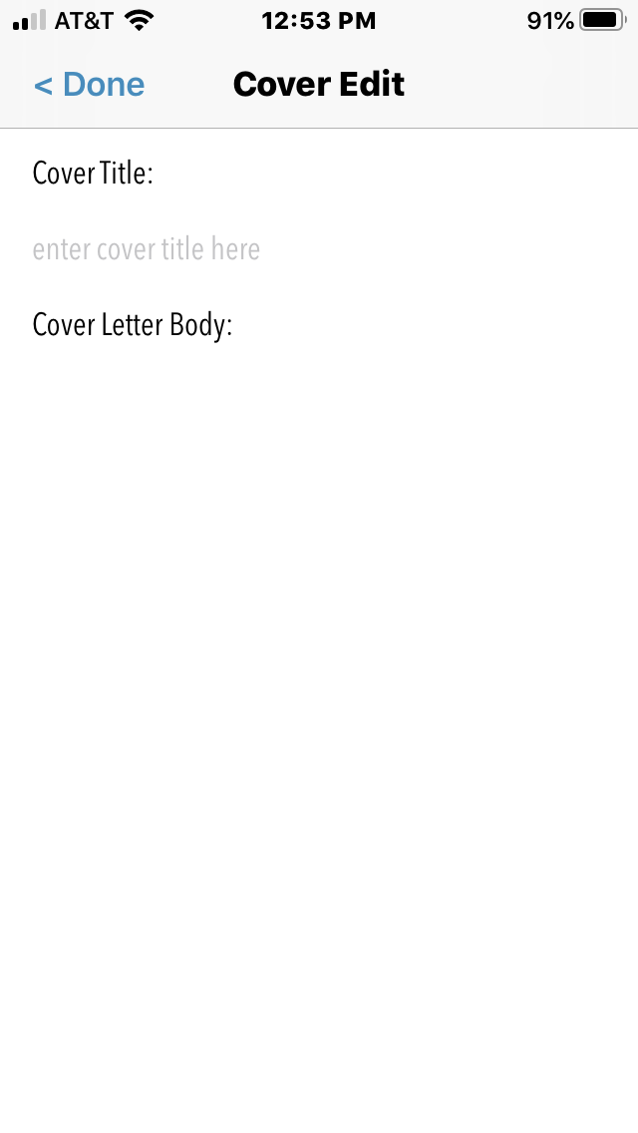
Cover Edit
Selecting “Blank Cover Letter” will bring you to a screen where you can create a new Cover Letter.

Slide 34
Default Screen
Now that we have explored the Job Searching function, let’s take a look at the menu. To begin, choose the icon with the three bars.

Slide 35
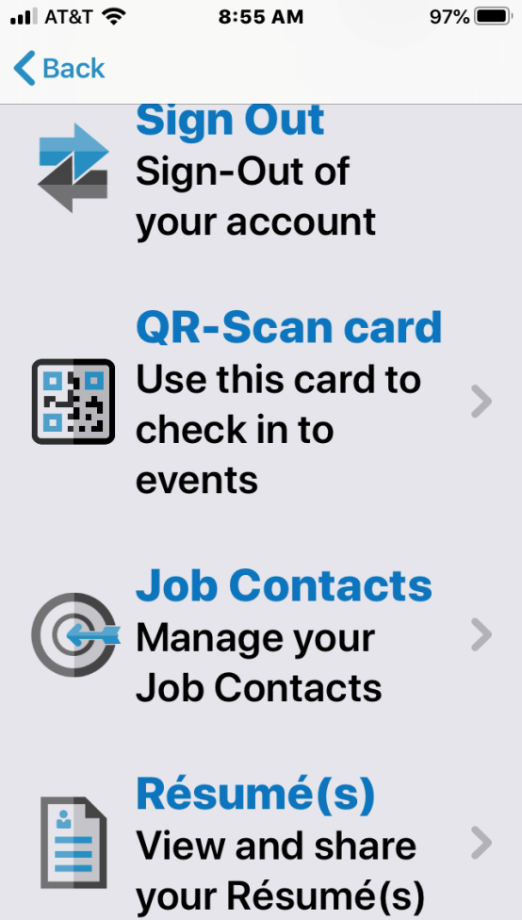
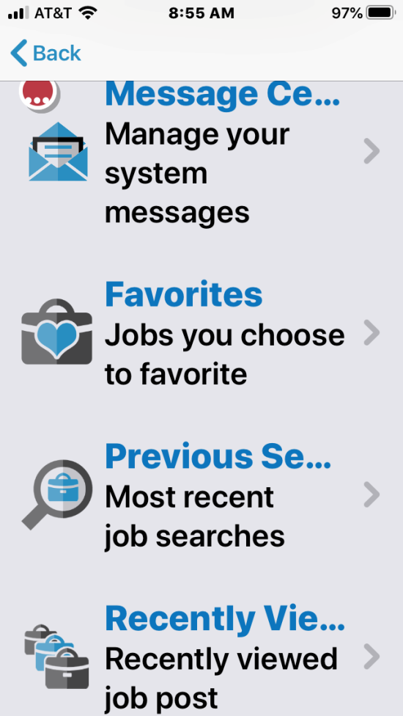
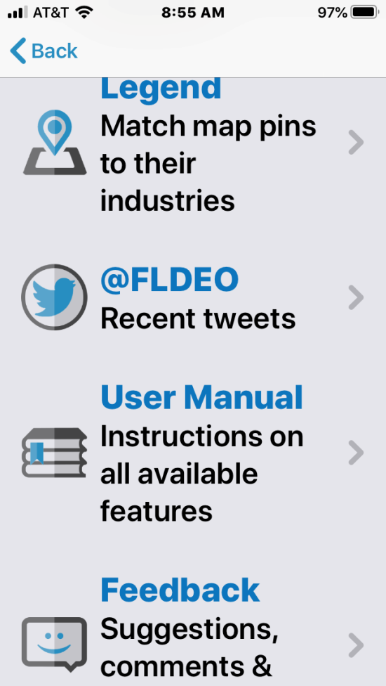
Menu
These are the items listed in the menu. As a guest, you do not have access to all of these. Let’s look at each one.

Slide 36
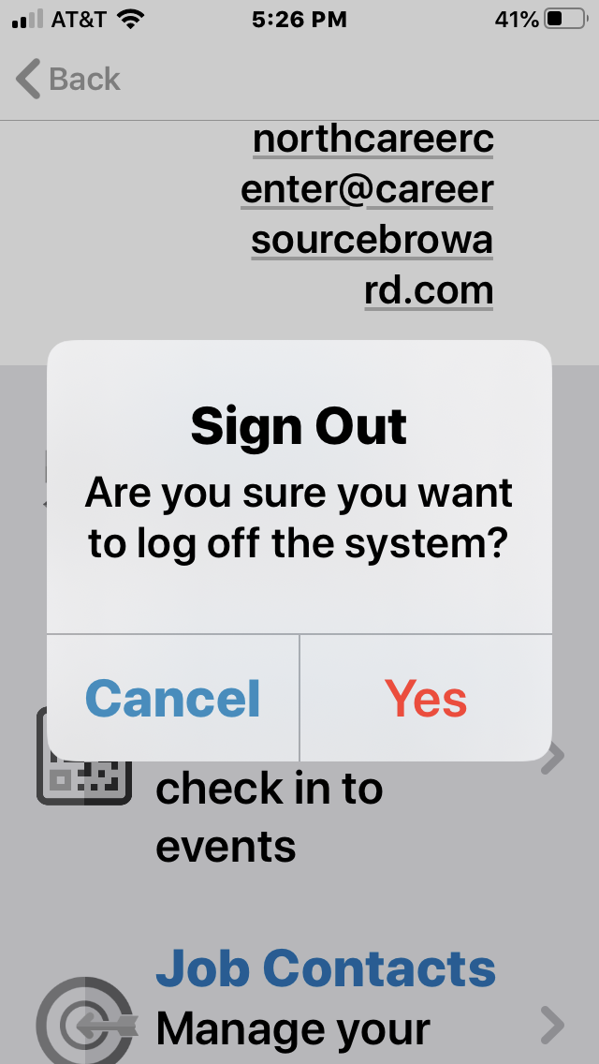
Sign Out
When you are ready to exit the EF app, choose “Yes” on the Sign Out screen.

Slide 37
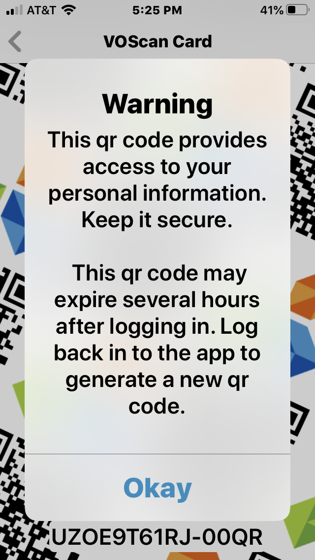
QR-Scan Card
When you choose “Okay,” you will be provided with a Quick Response code that can be scanned wherever QR codes are used.

Slide 38
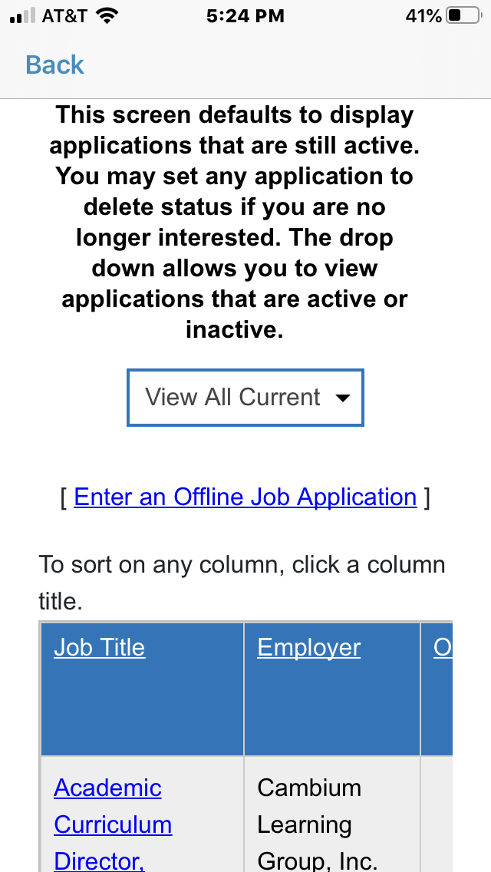
Job Contacts
You can organize the jobs you have searched by Job Title, Employer, or other categories.

Slide 39
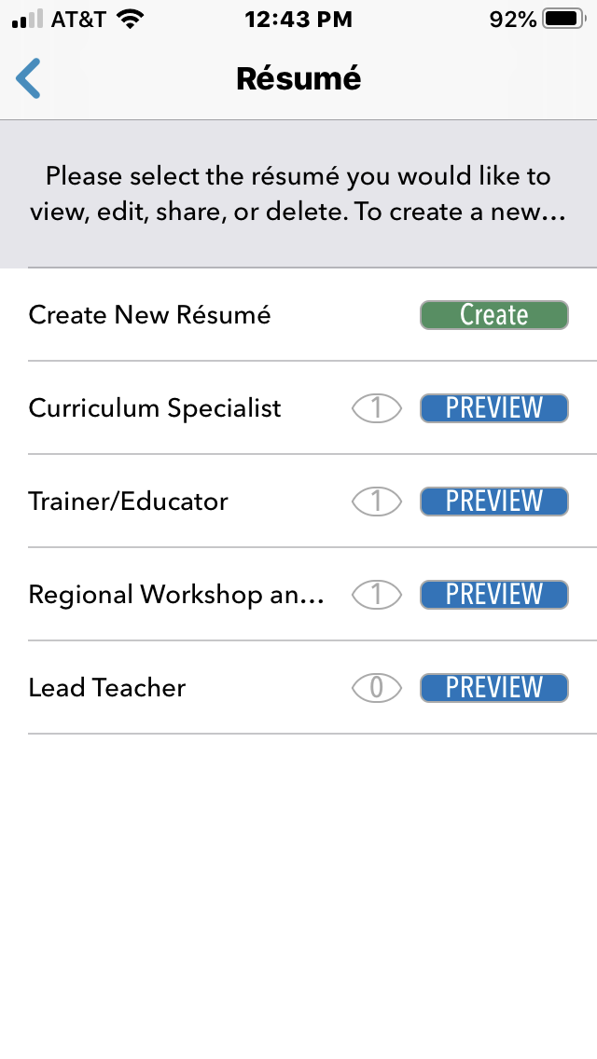
Résumé
The Résumé section allows you to PREVIEW résumés you already have in the system. You may also choose “Create” to add a new résumé.

Slide 40
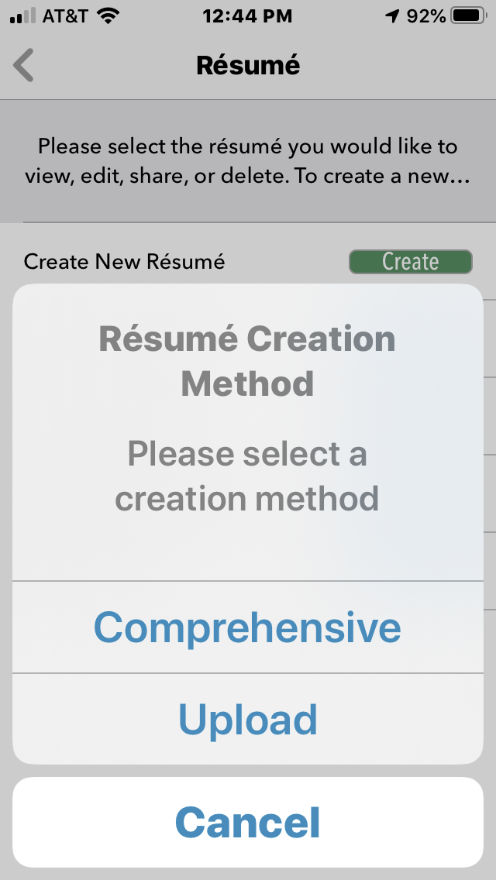
Résumé
When creating a new résumé, you have a choice of building it from a template (“Compre-hensive”) or uploading one you already have (“Upload”).

Slide 41
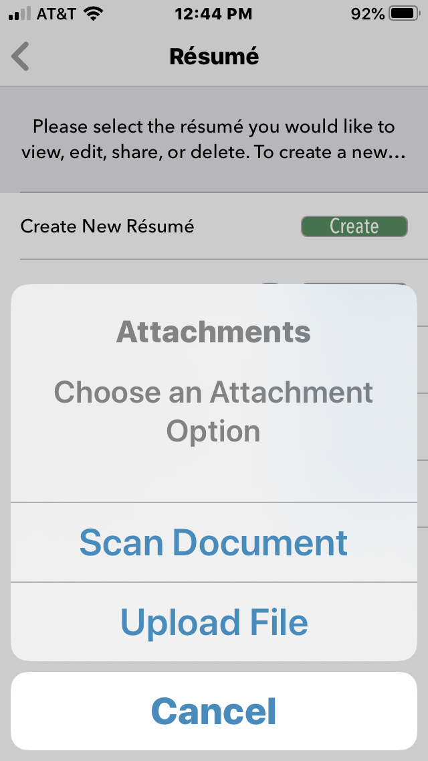
Résumé
If you choose the “Upload” option, you can scan a document or upload an existing file.

Slide 42
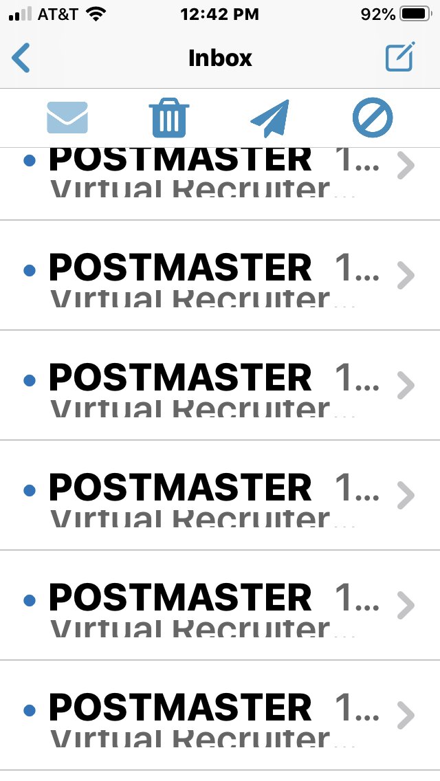
Message Center
Your inbox contains all your messages, including notifications from the Virtual Recruiter, which searches for jobs suited to you.

Slide 43
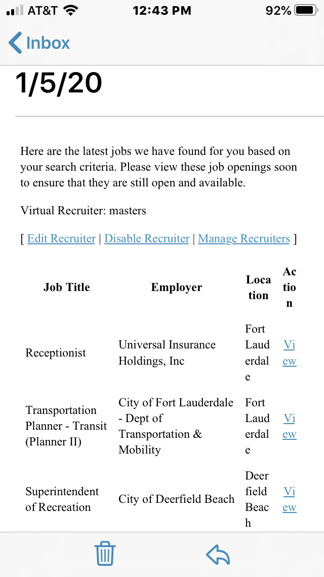
Message Center
When you open a message from the Virtual Recruiter, it will display the latest jobs based on your search criteria.

Slide 44
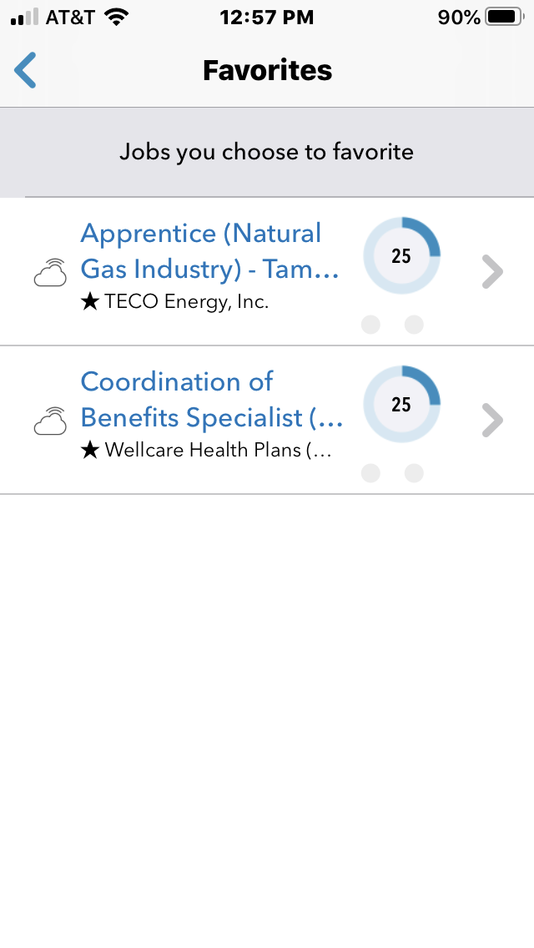
Favorites
Any jobs that you selected as “Favorites” appear here for your quick reference.

Slide 45
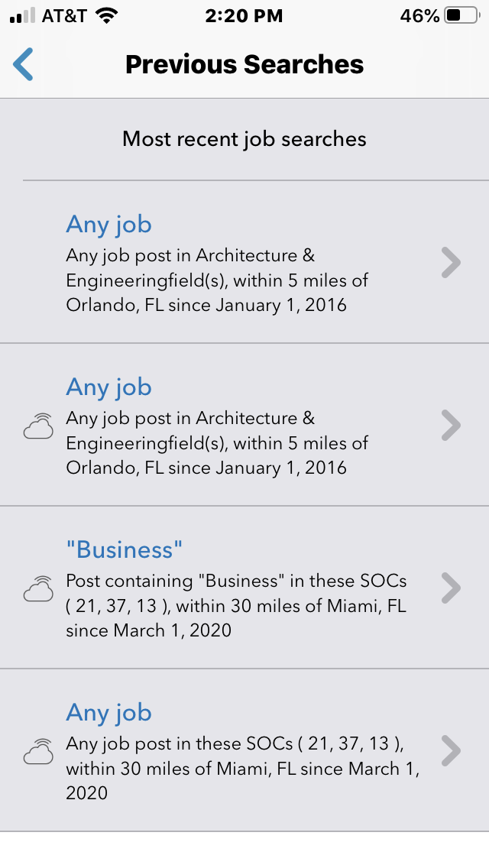
Previous Searches
Your most recent job searches have been saved, and you have the option to reopen a previous search by selecting it.

Slide 46
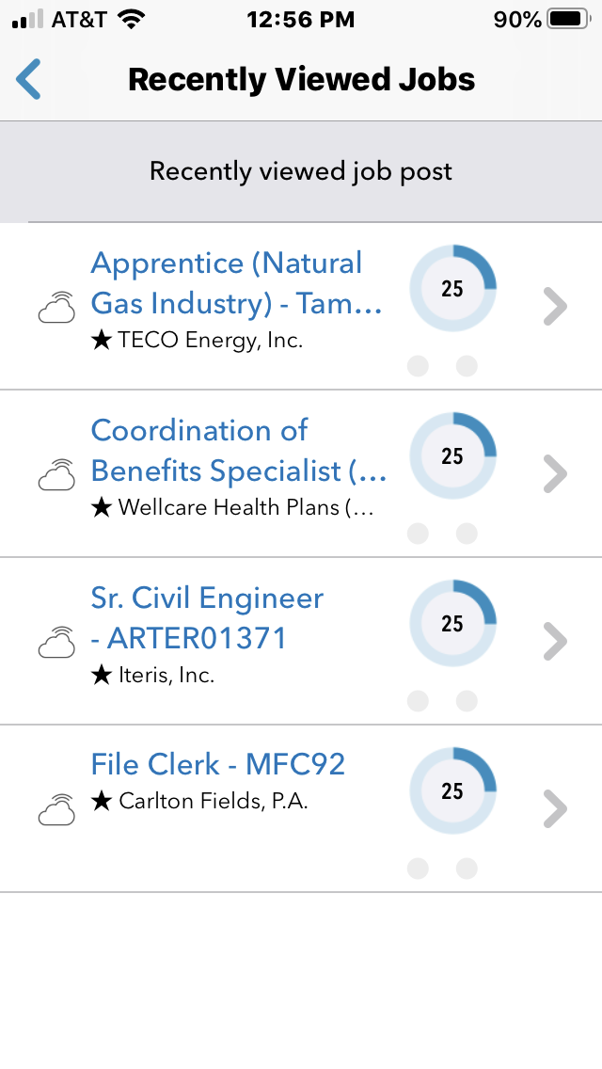
Recently Viewed Jobs
All recently viewed jobs are stored in this section for quick reference.

Slide 47
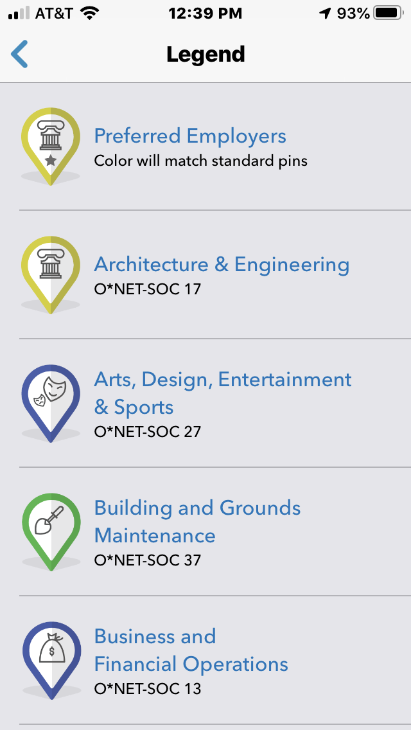
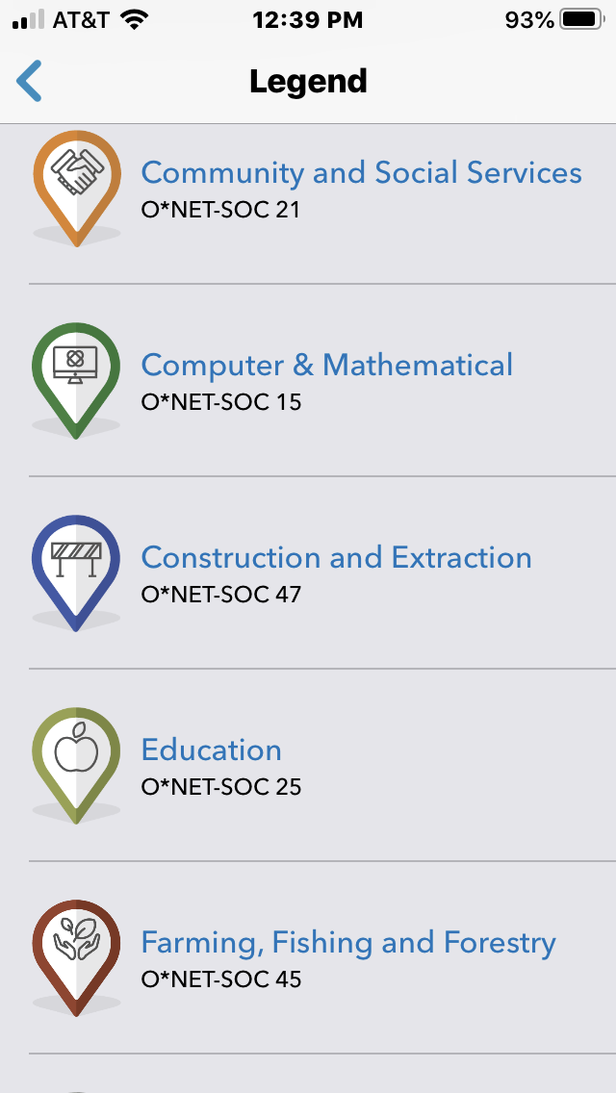
Legend
Each job category is classified by a separate icon.

Slide 48
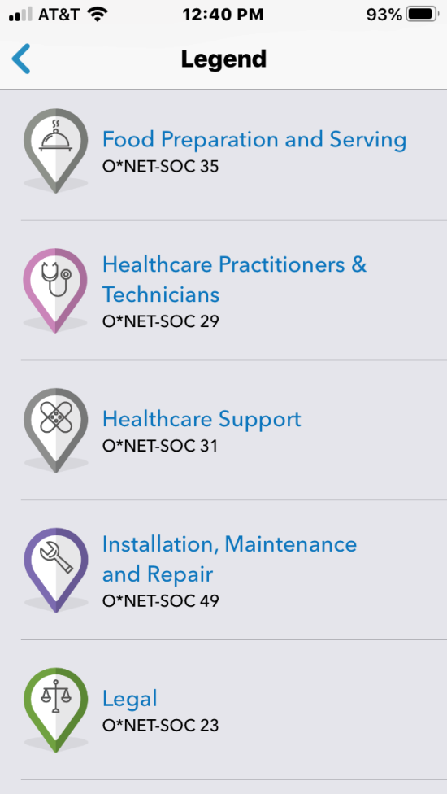
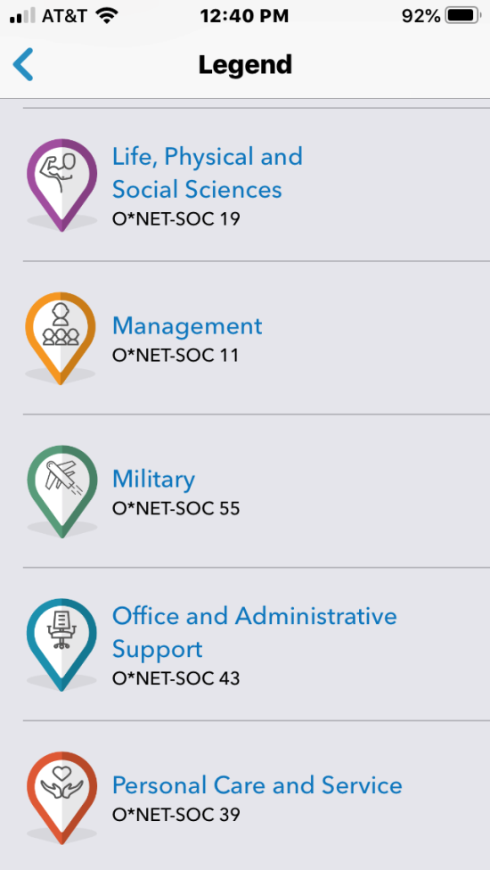
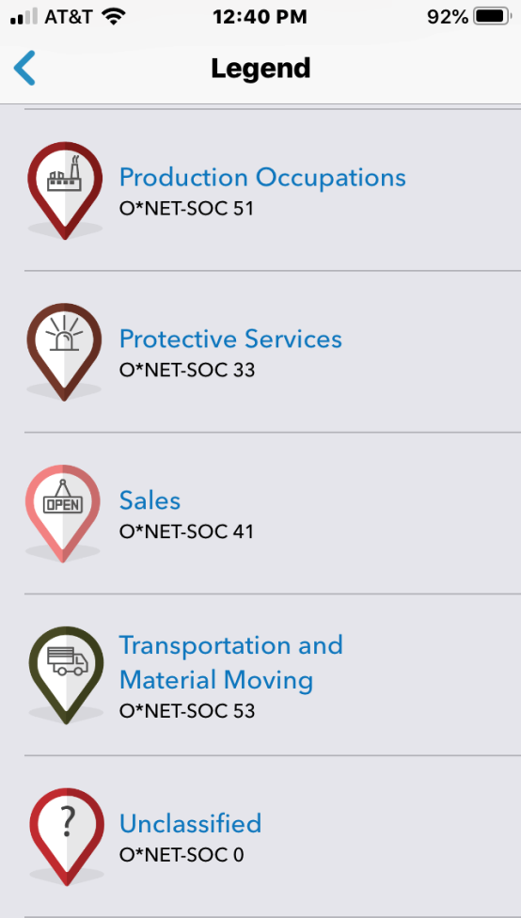
Legend
On the location maps, you can easily match a map pin to an industry using the Legend.

Slide 49
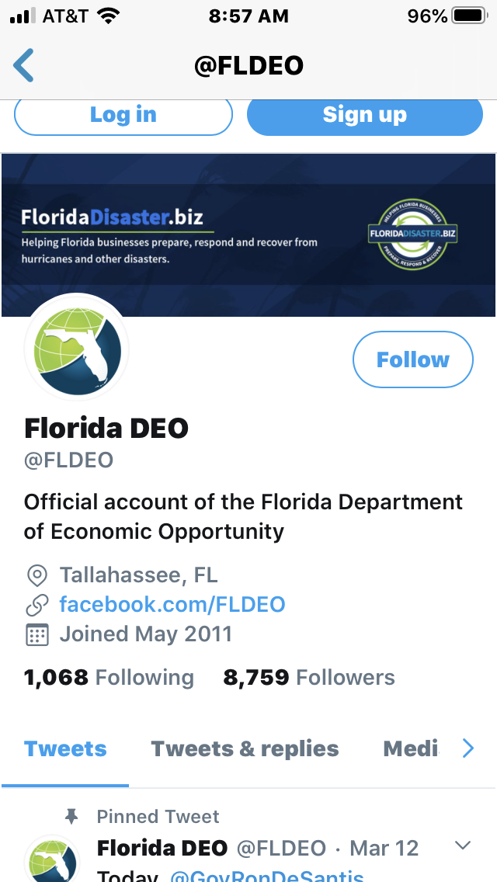
@FLDEO
The app provides direct access to recent tweets from the Florida Department of Economic Opportunity’s Twitter account.

Slide 50
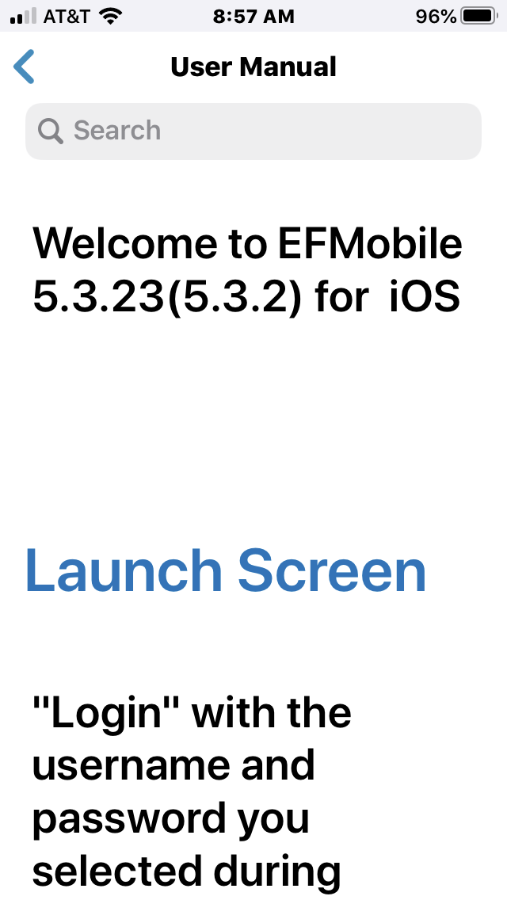
User Manual
Your guide to all available features is found in the User Manual.

Slide 51
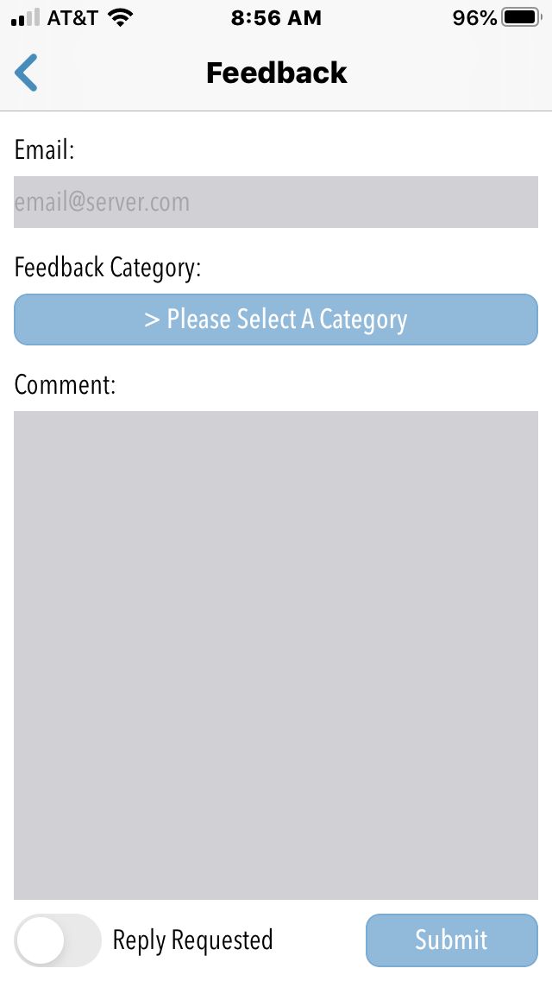
Feedback
To provide feedback about the app, enter your Email, choose a Feedback Category, enter your Comment, choose whether you would like a Reply, and choose “Submit.”

Slide 52
Be sure to check out the Employ Florida app frequently for new job postings.

Slide 53
Thank you for watching
and good luck
in your job search!
For more resources, please visit us at www.careersourcebroward.com

